Slide 1


Customer Personality Analysis
Group 2

Slide 2
Objective of the Project
The idea is to identify specific demands and main points within each segment and to classify clients into discrete categories based on a variety of features and behaviours.

Slide 3
EXPLORATORY DATA ANALYSIS
Procedure for Conducting Exploratory Data Analysis:
Bring in all required libraries and presenting all of the data set's necessary data
Finding Missing Values, Duplicate Rows, and Removing Redundant Rows
Utilising Univariate_ Analysing and combining related categories into a single column
Using bivariate analysis Analysis to compare the features and expenses
Removing Outliers and Normalising the Data.

Slide 4
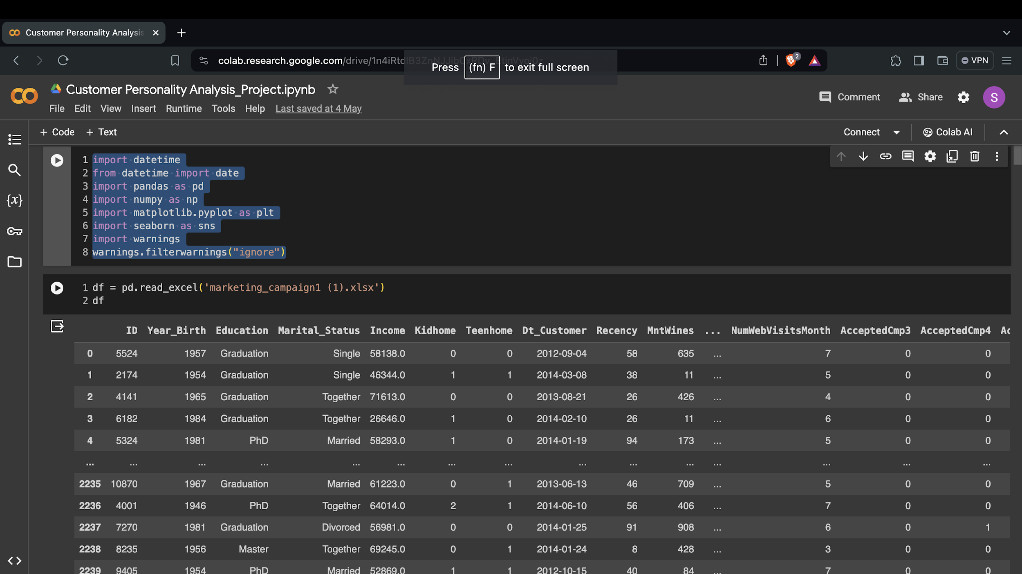
Bring in all required libraries and presenting all of the data set's necessary data

Slide 5
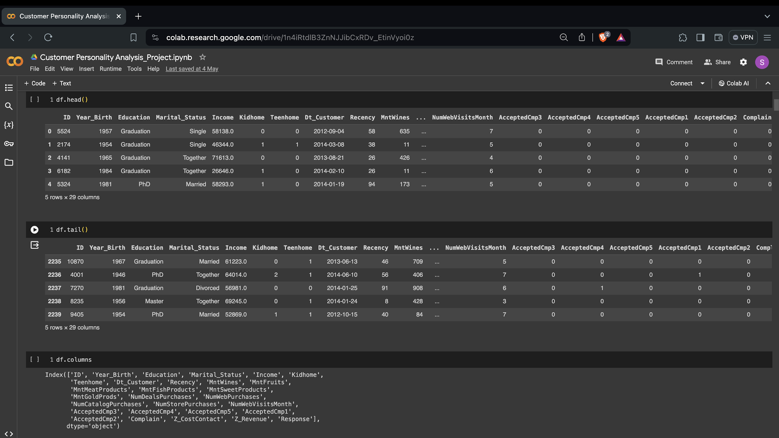
Bring in all required libraries and presenting all of the data set's necessary data

Slide 6
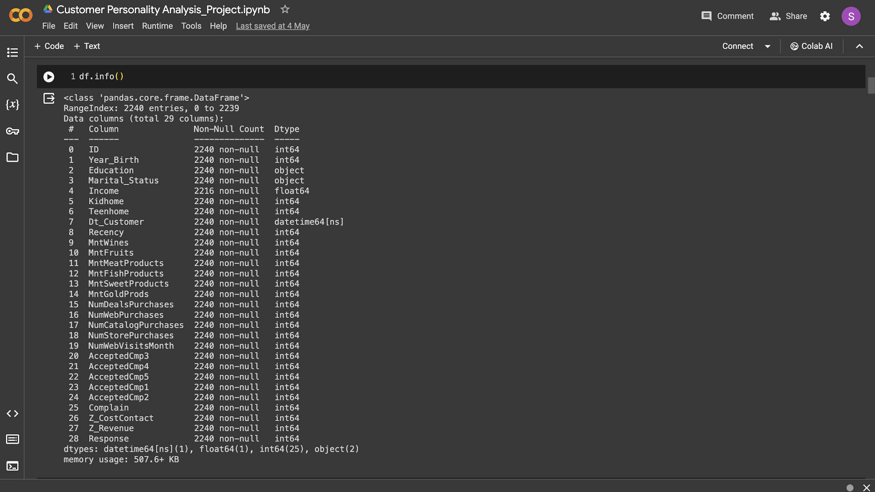
Bring in all required libraries and presenting all of the data set's necessary data

Slide 7
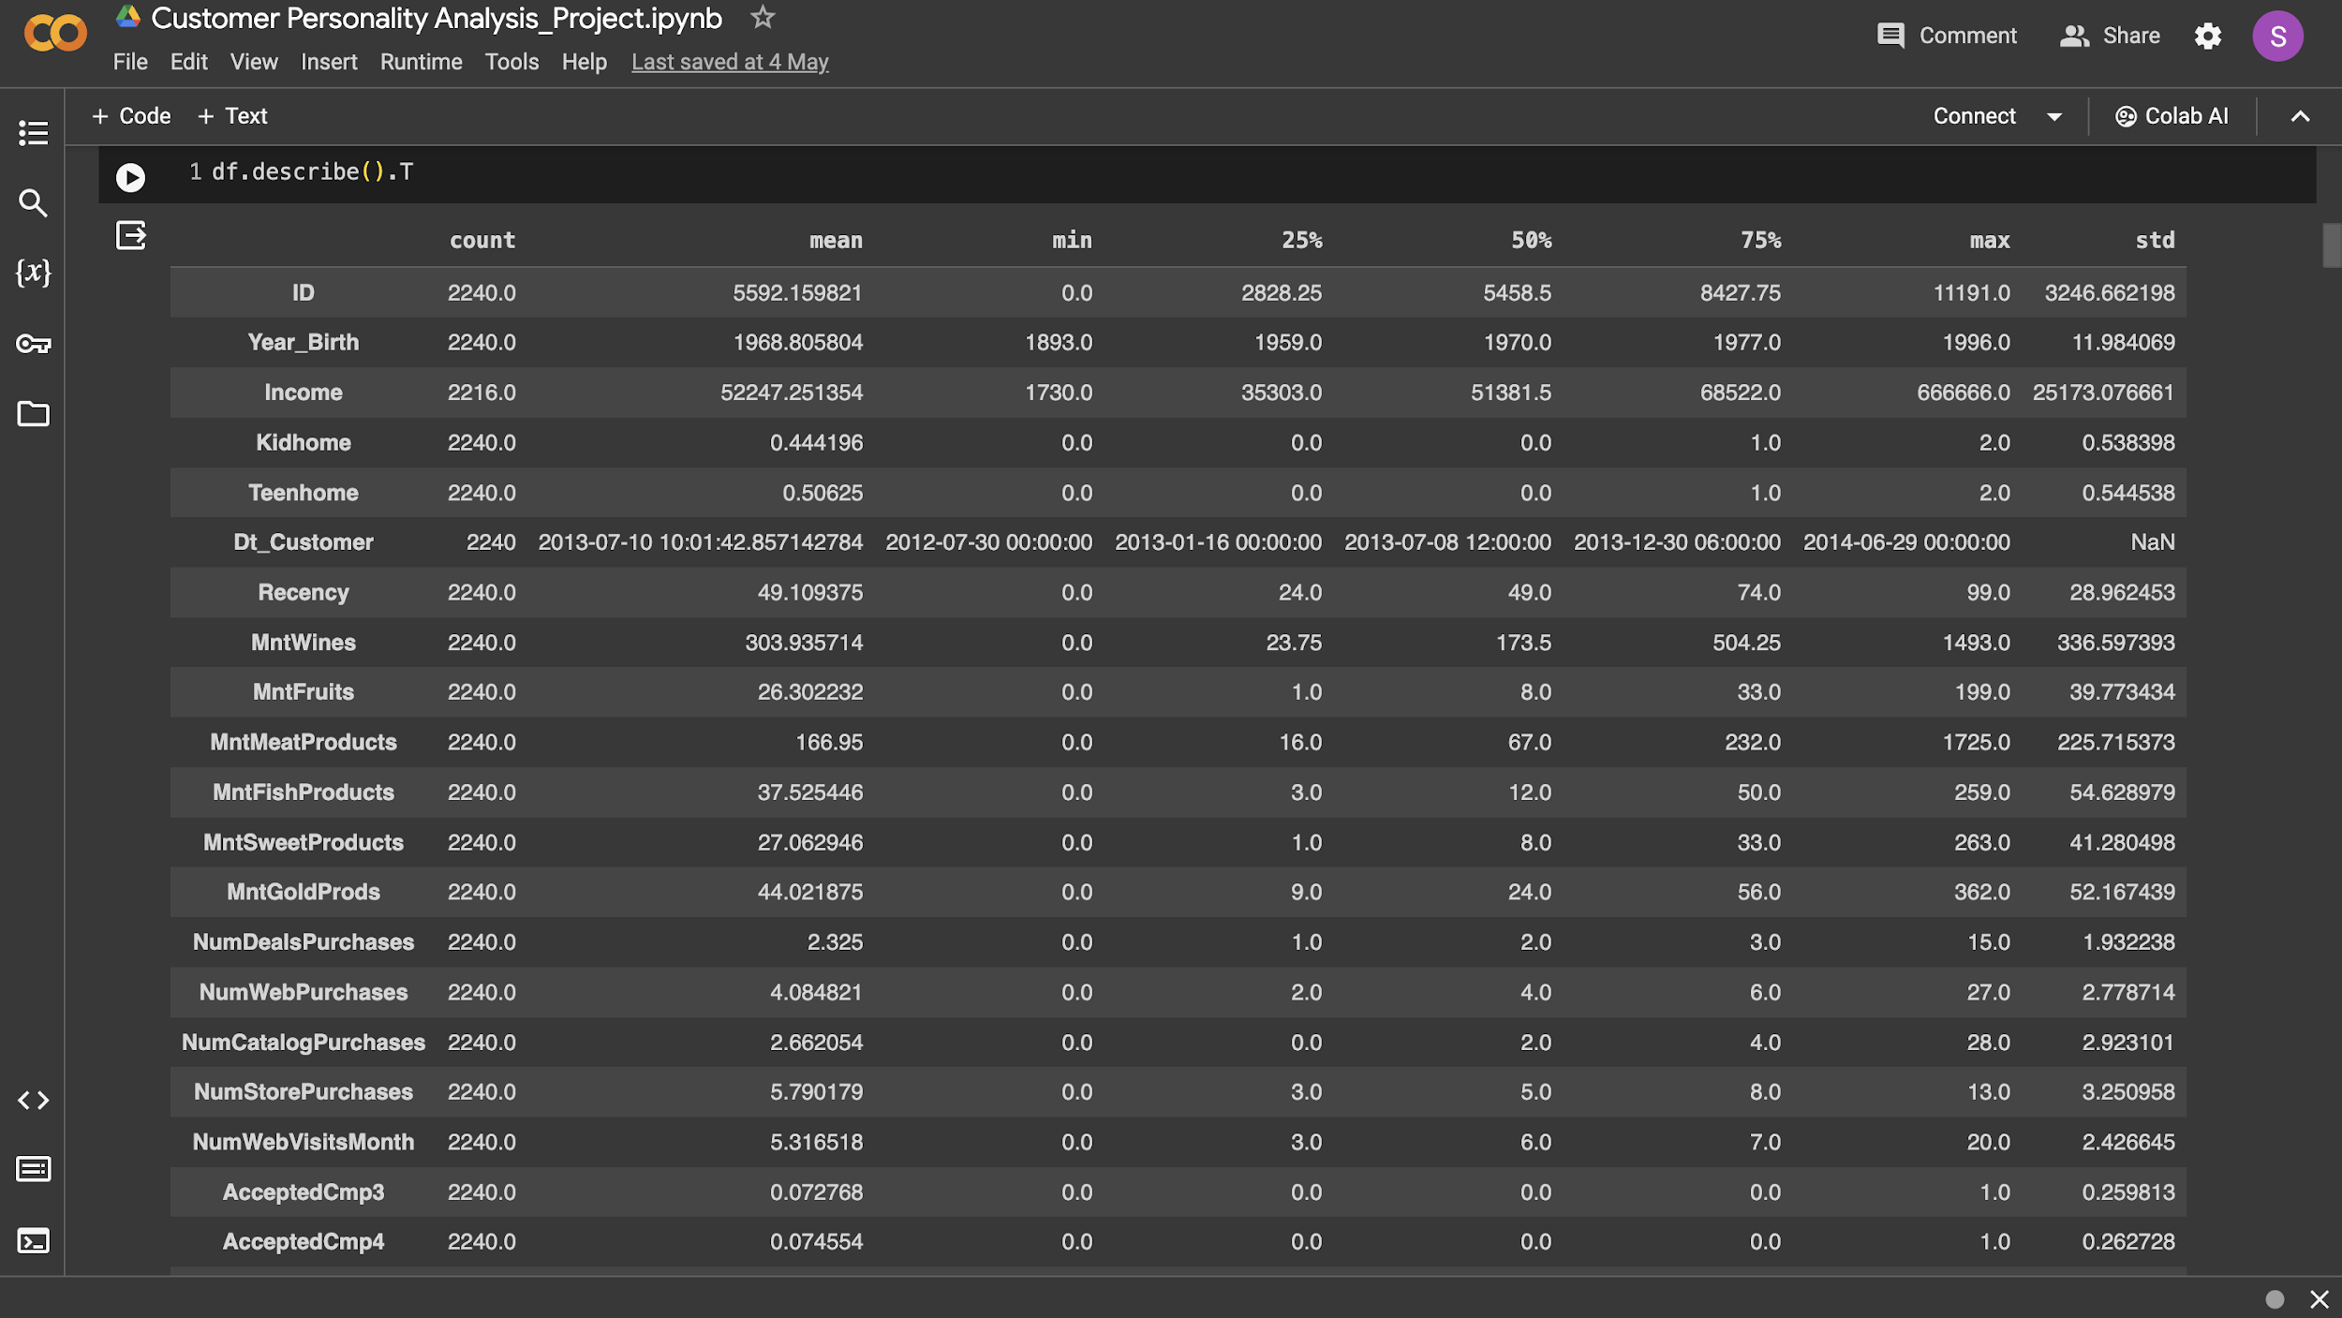
Bring in all required libraries and presenting all of the data set's necessary data

Slide 8
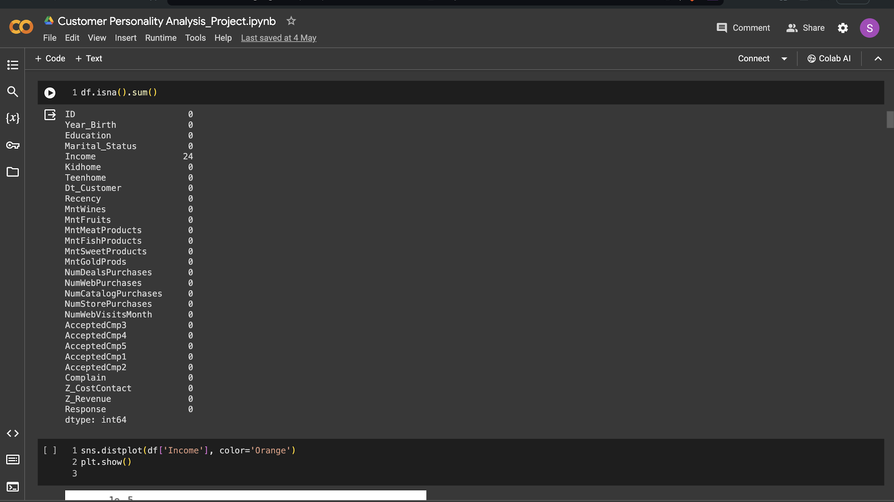
Finding Missing Values, Duplicate Rows, and Removing Redundant Rows

Slide 9
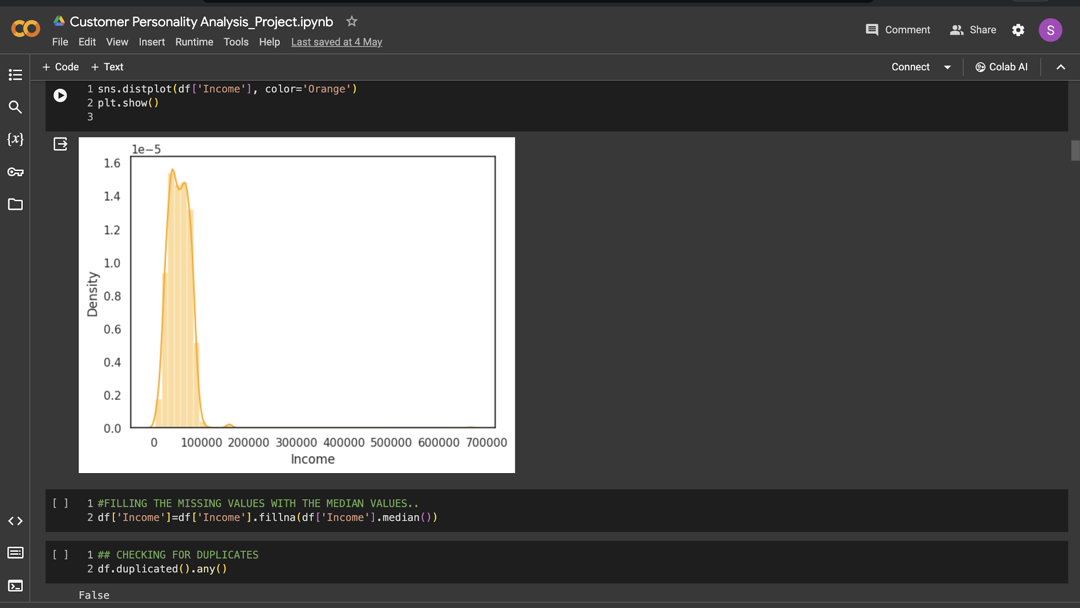
Finding Missing Values, Duplicate Rows, and Removing Redundant Rows
After observing the graph we can conclude that the data is not a normal distribution and is left skewed. Hence, we use median to fill in the missing values.

Slide 10
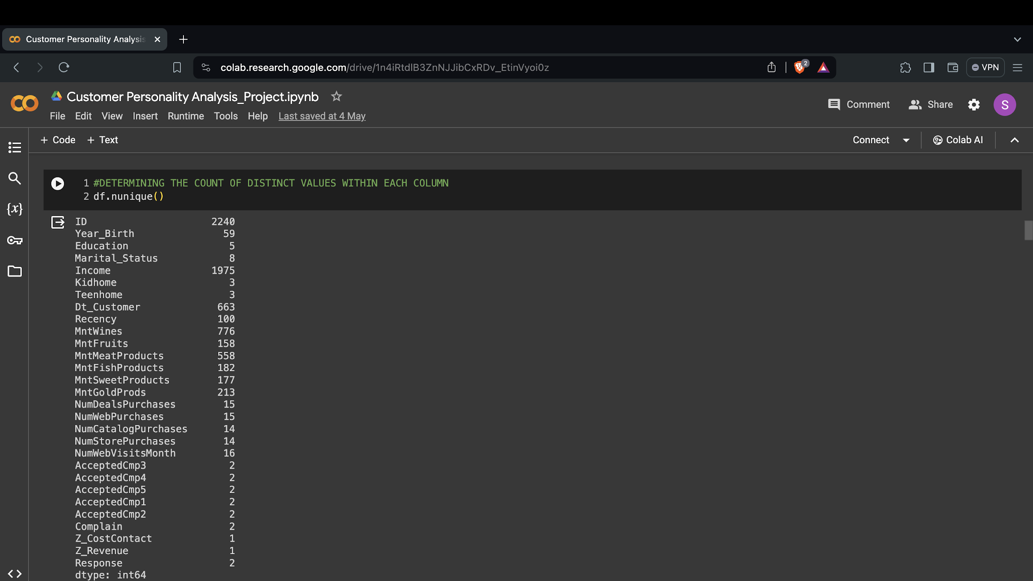
Finding Missing Values, Duplicate Rows, and Removing Redundant Rows
In the above cell, "Z_CostContact" and "Z_Revenue" have the identical value in every row, thus they won't contribute anything to the model's creation. So we drop these two columns

Slide 11
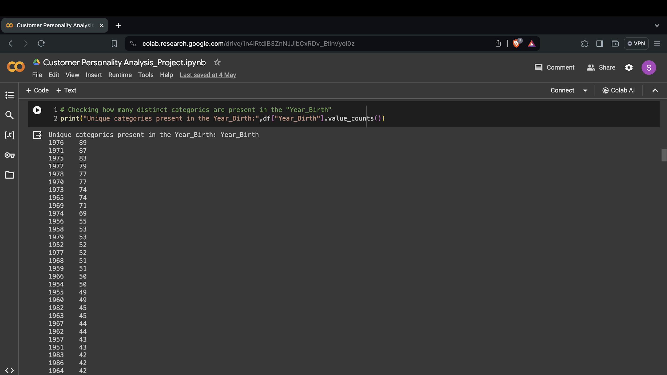
Utilising Univariate_ Analysing and combining related categories into a single column

Slide 12
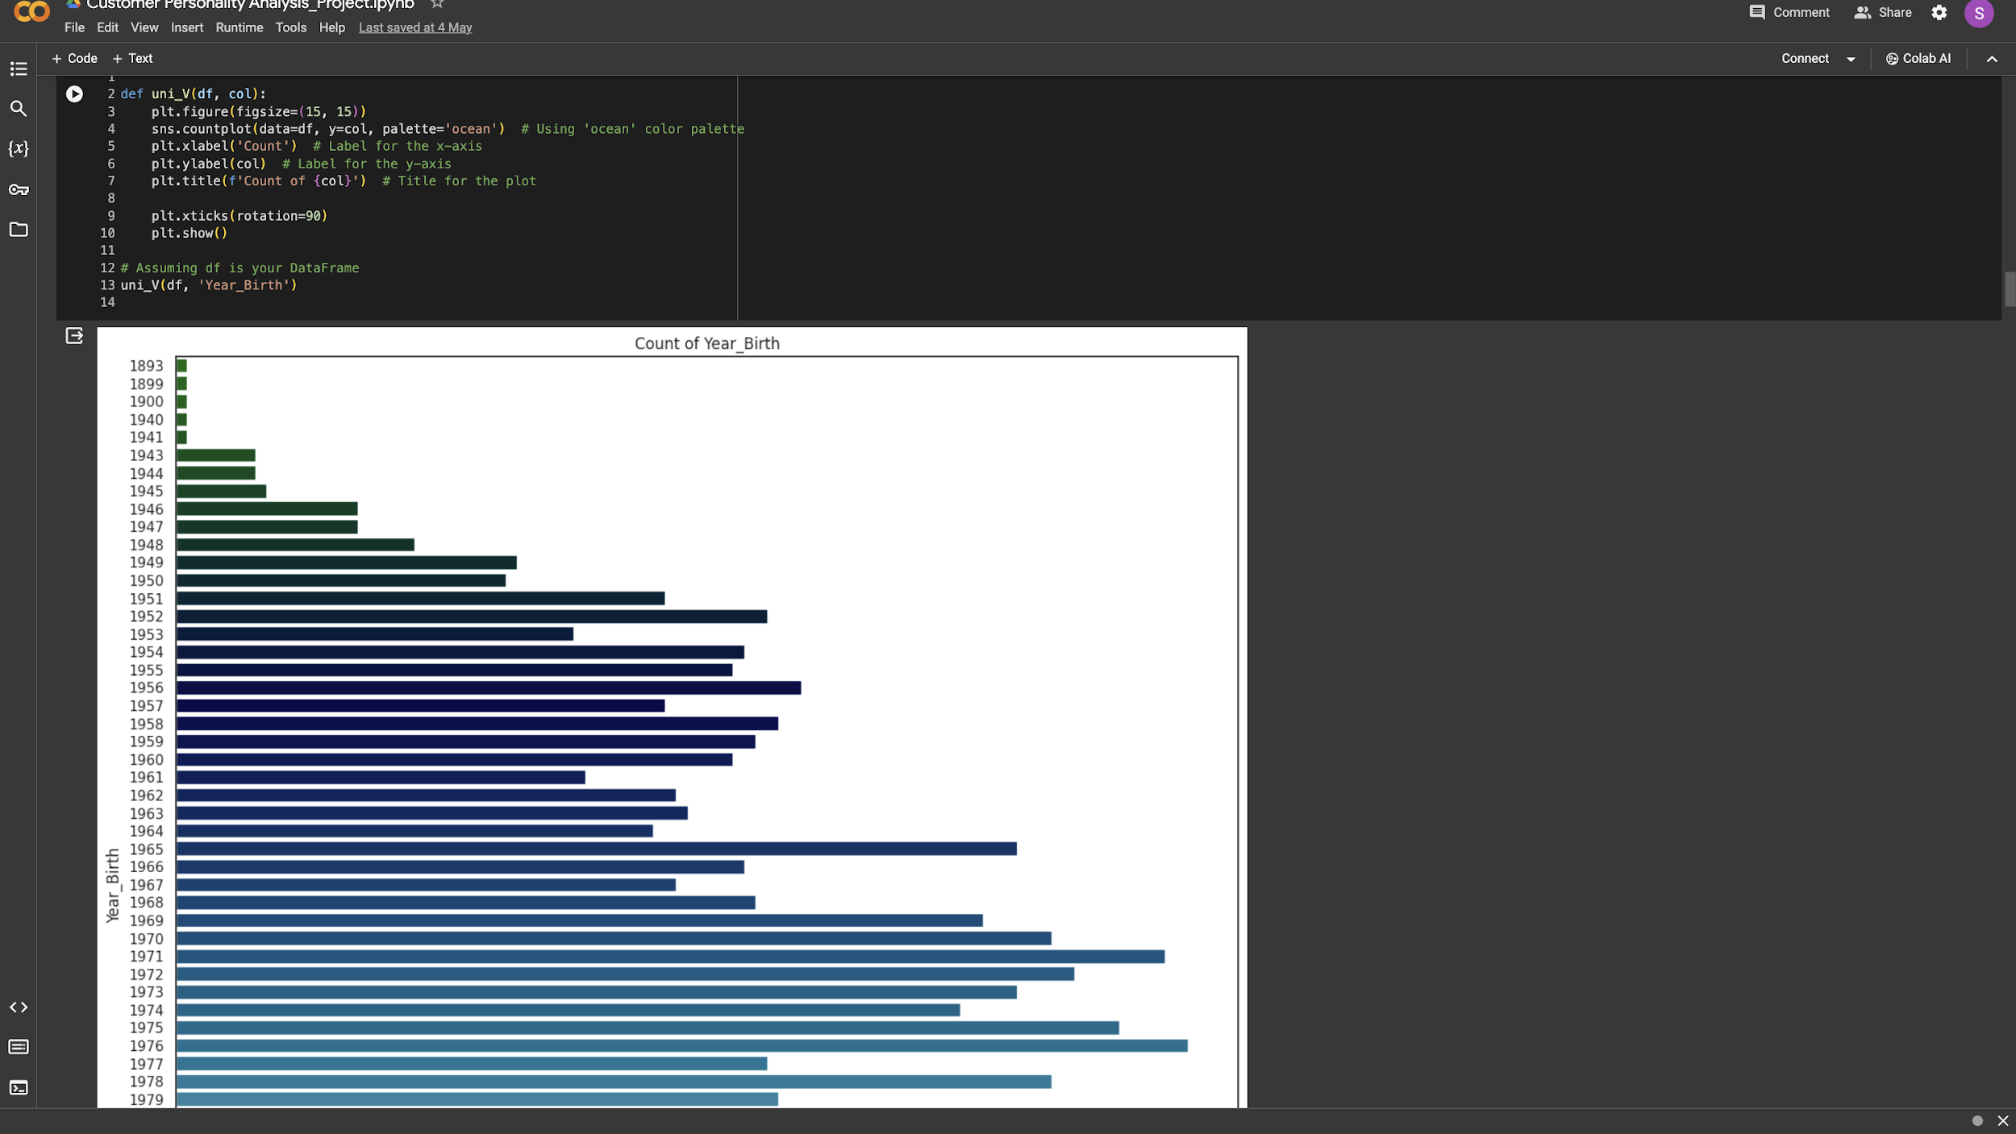
Utilising Univariate_ Analysing and combining related categories into a single column
The above graph represent year birth and the data is uniformly distributed

Slide 13
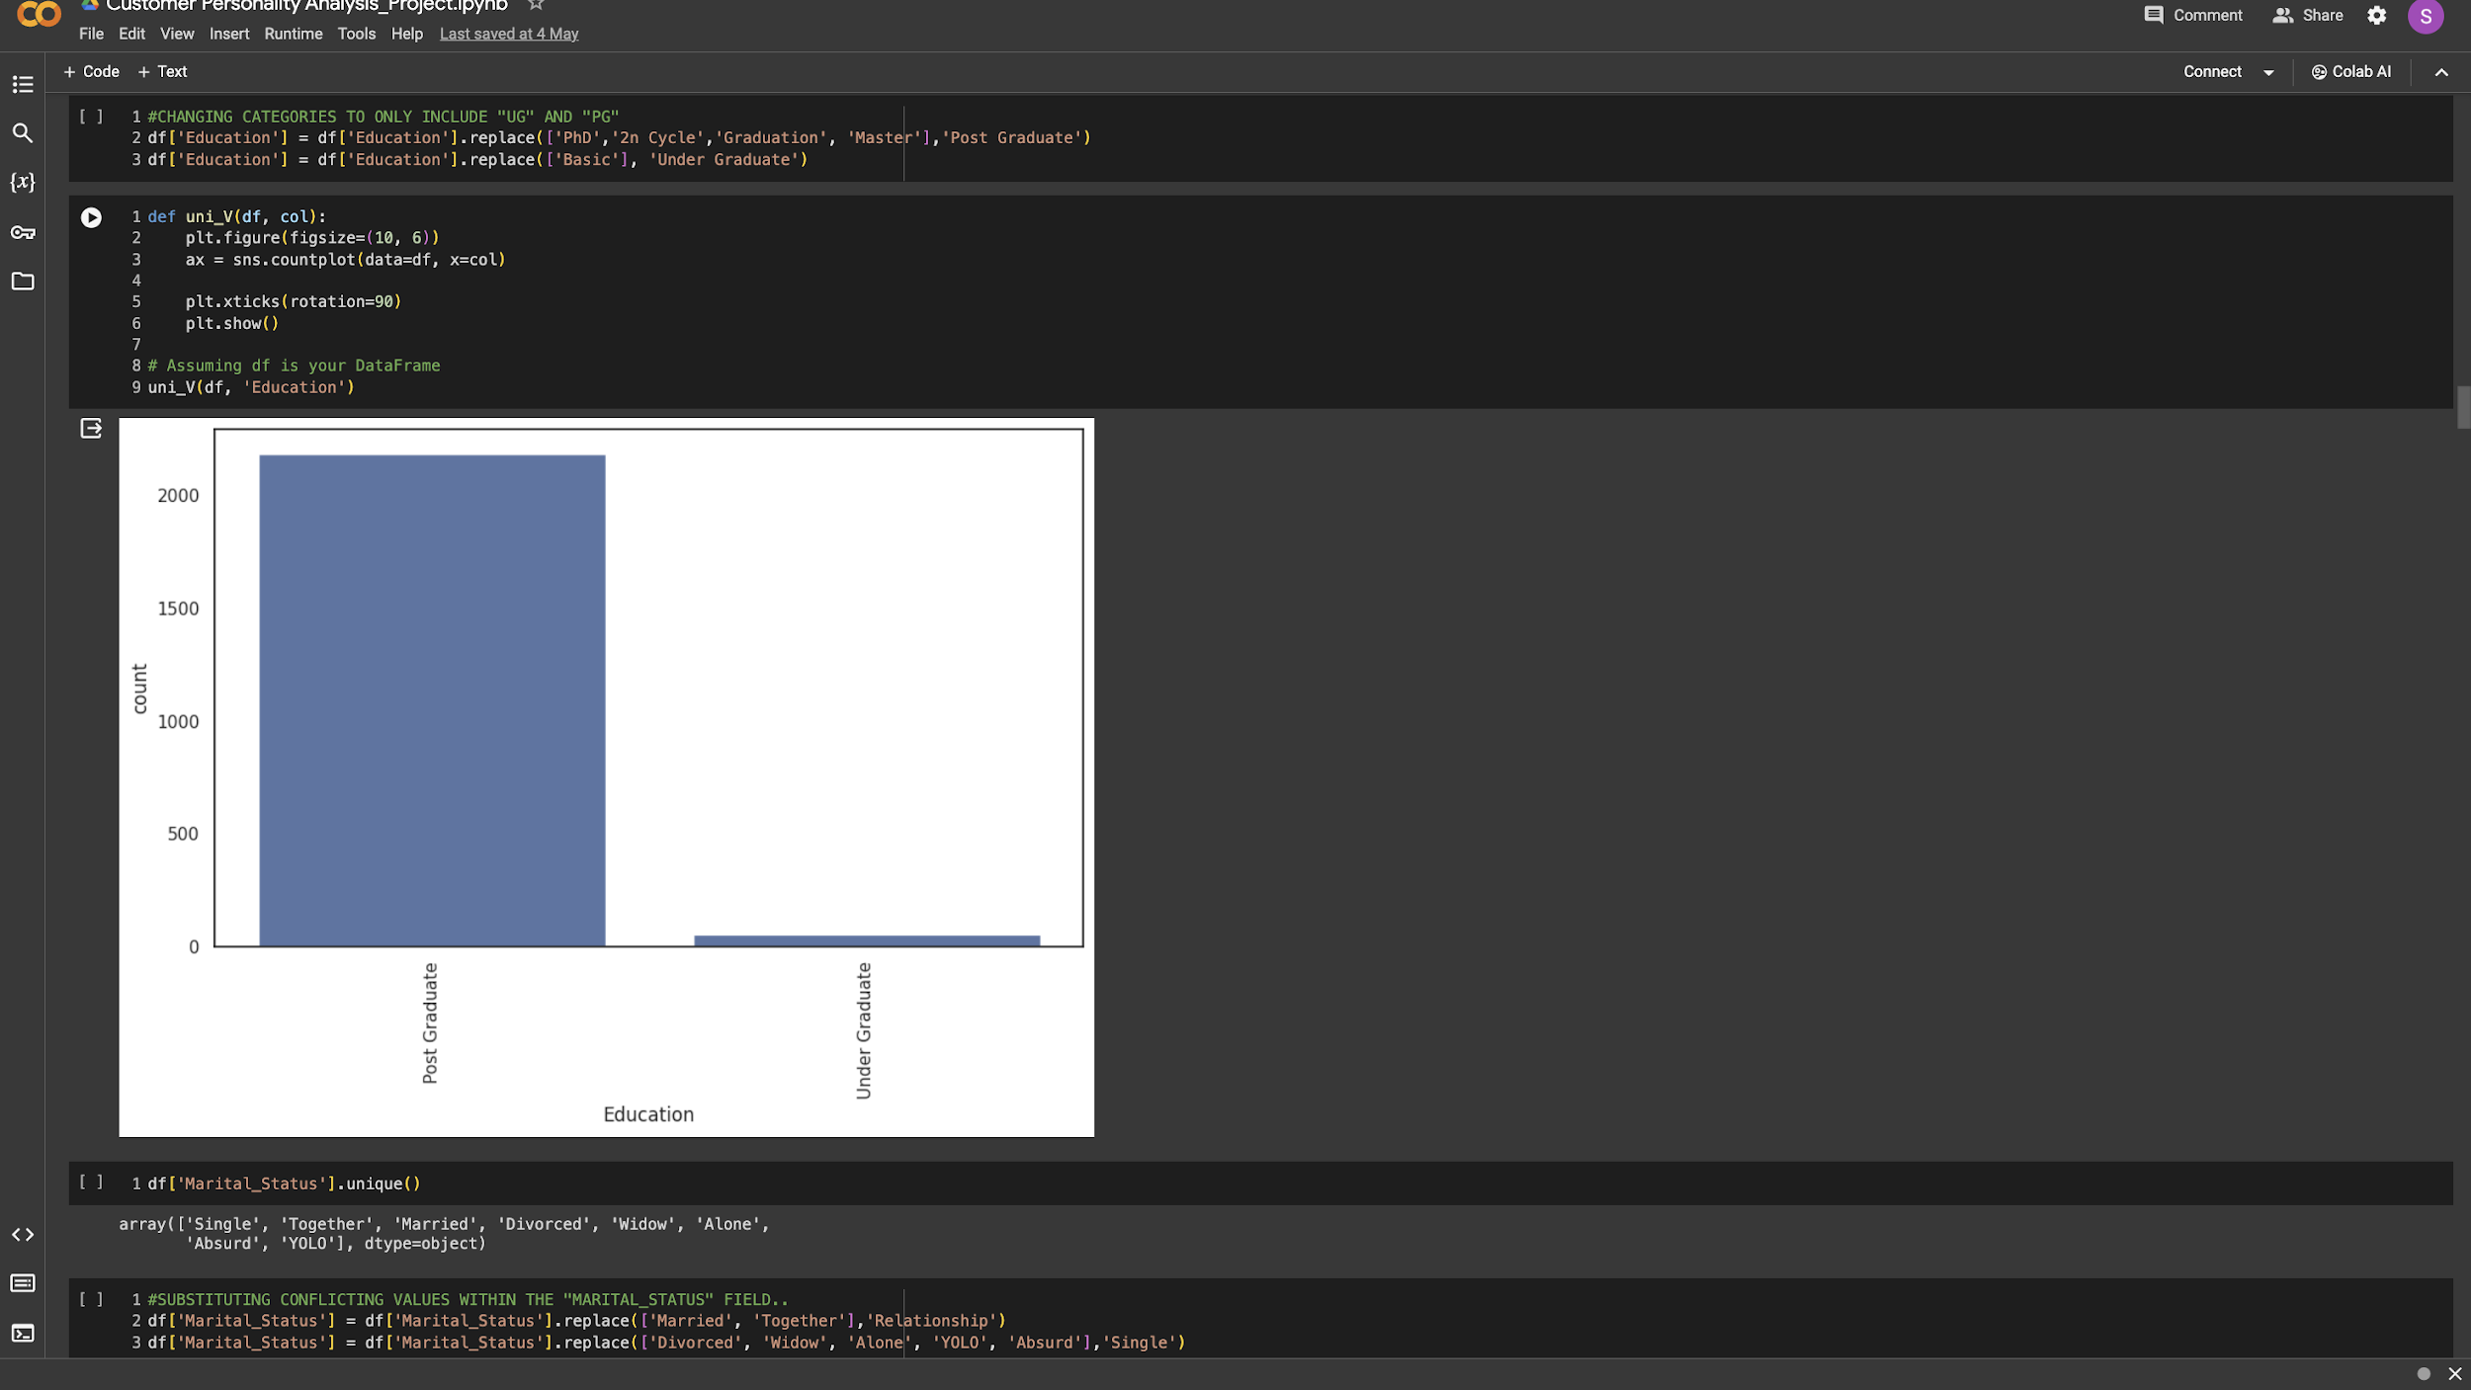
Utilising Univariate_ Analysing and combining related categories into a single column
Here we are combining multiple features into two which are Post Graduate and Under Graduate and according the display count plot majority of the data points is held by Post Graduate

Slide 14
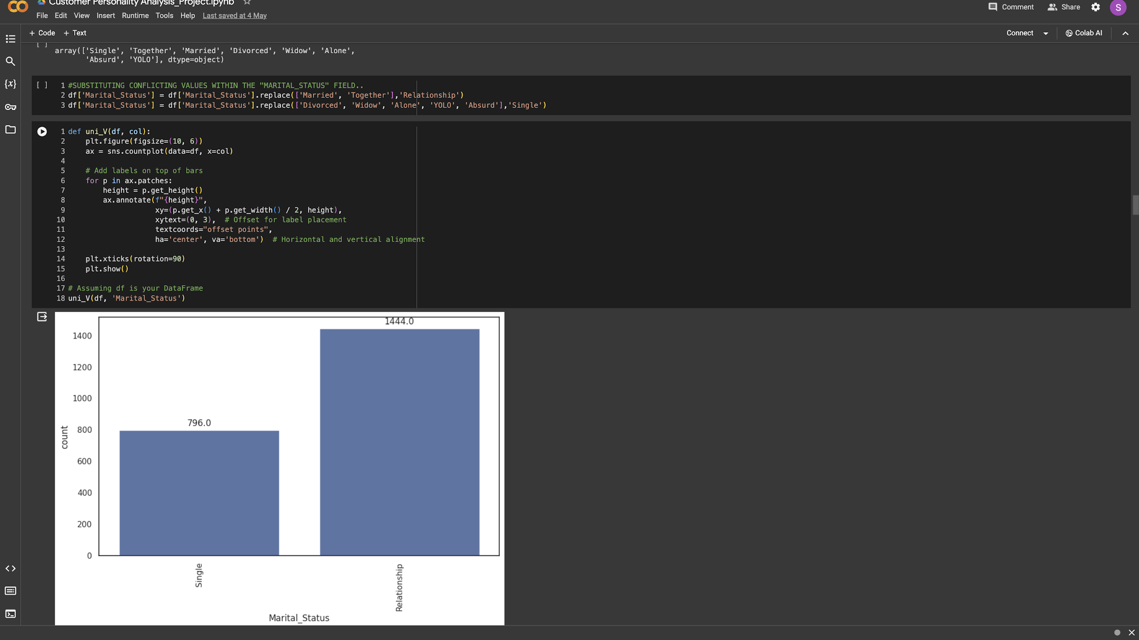
Utilising Univariate_ Analysing and combining related categories into a single column
Here we are combining multiple features into two which are Single and Relationship. According the display count plot majority of the data points is held by Relationship

Slide 15
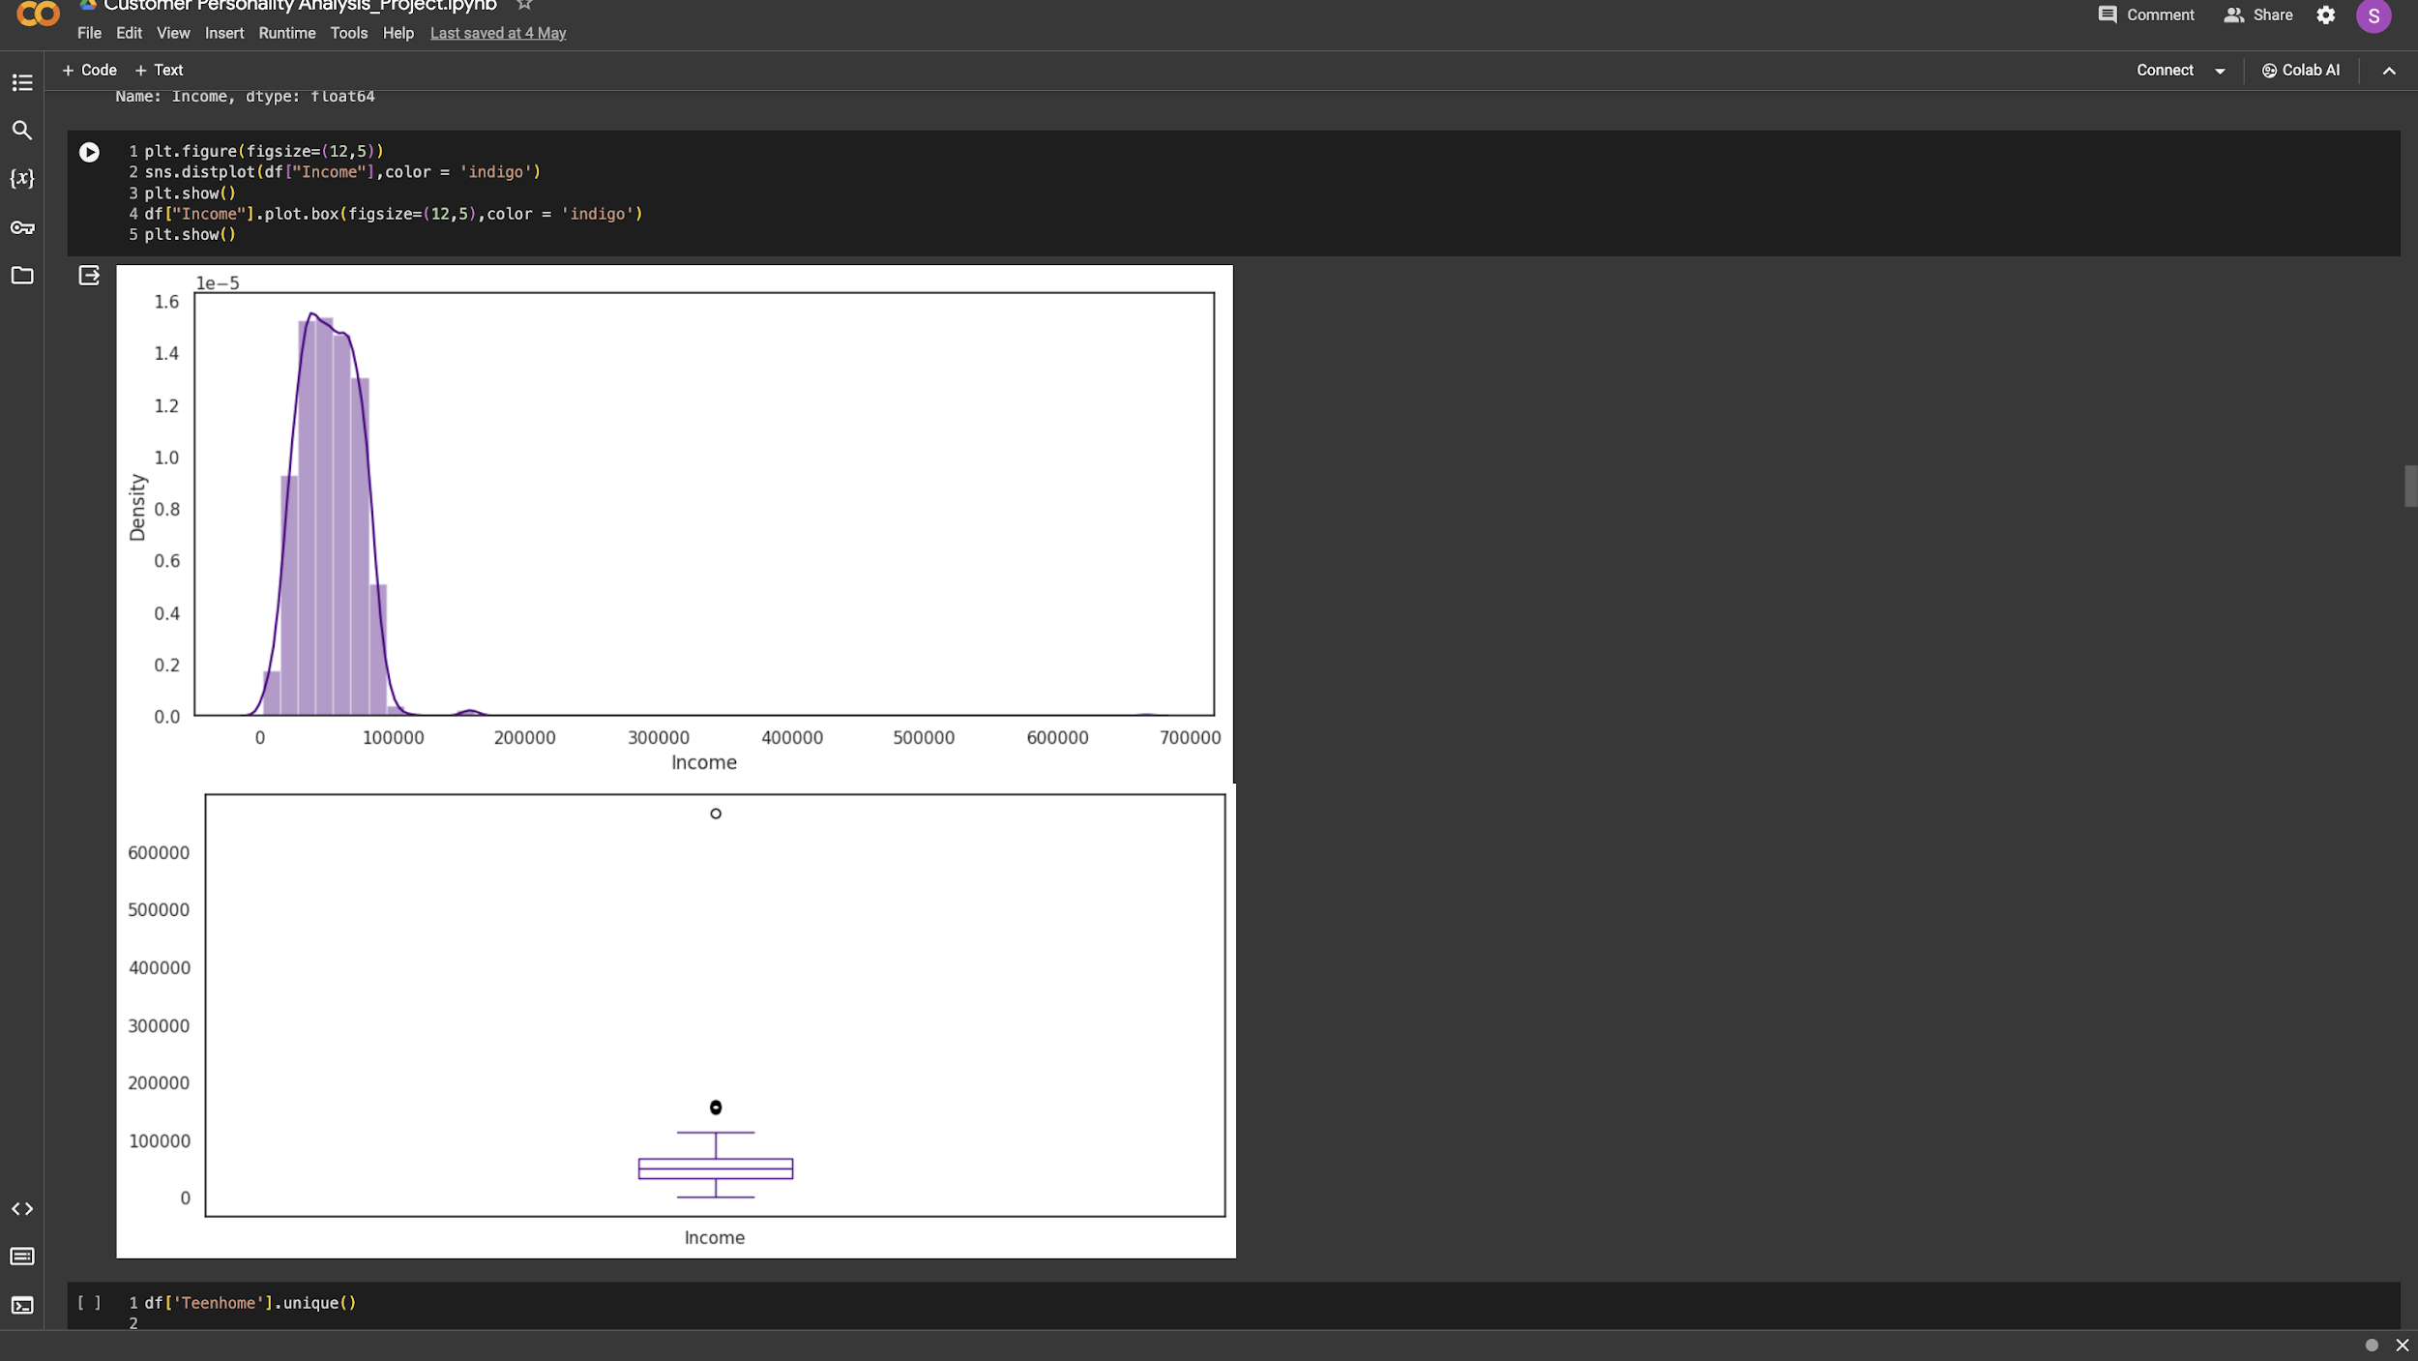
Utilising Univariate_ Analysing and combining related categories into a single column
According to the distplot and boxplot. The income column is left skewed as we previously observed, but there are a few outliers which will be address while developing the model.

Slide 16
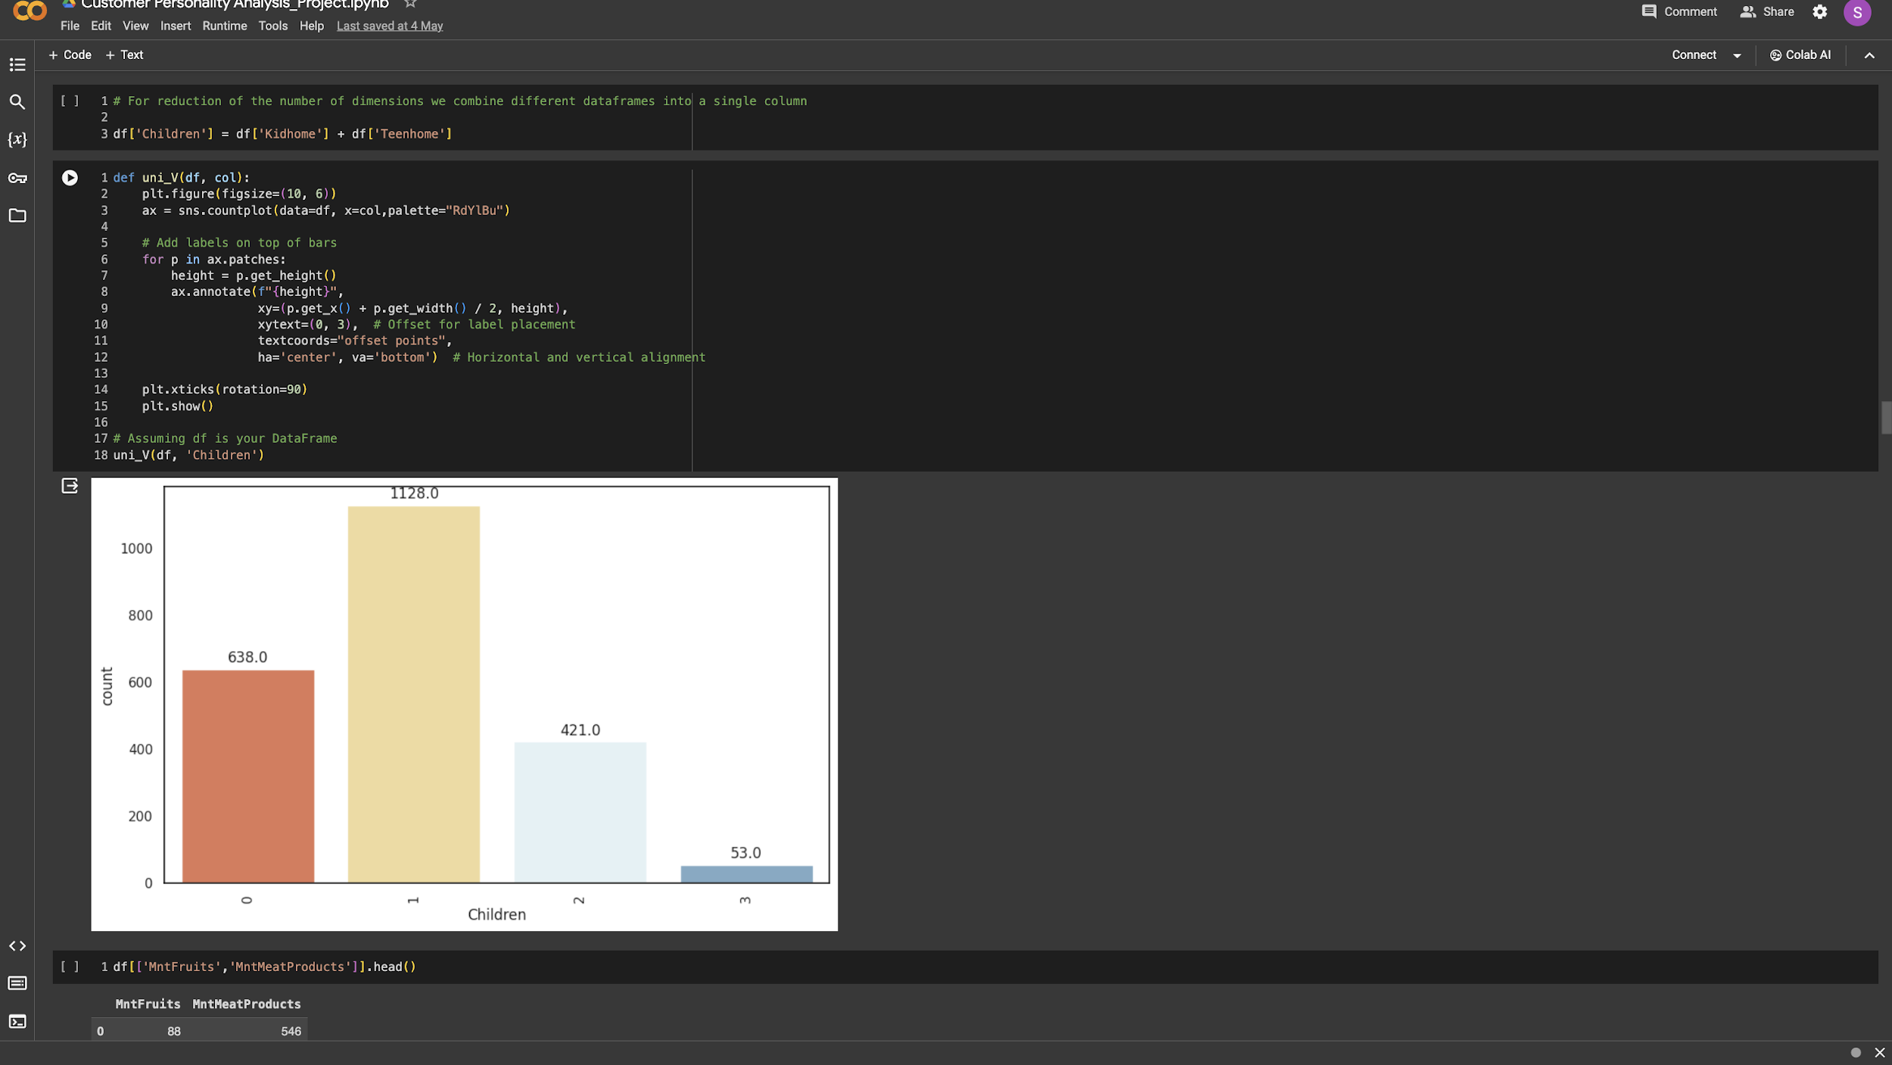
Utilising Univariate_ Analysing and combining related categories into a single column
Here we have multiple features under children column. According the display count plot majority of the data points is held by 1 child which is followed by zero, then two and three

Slide 17
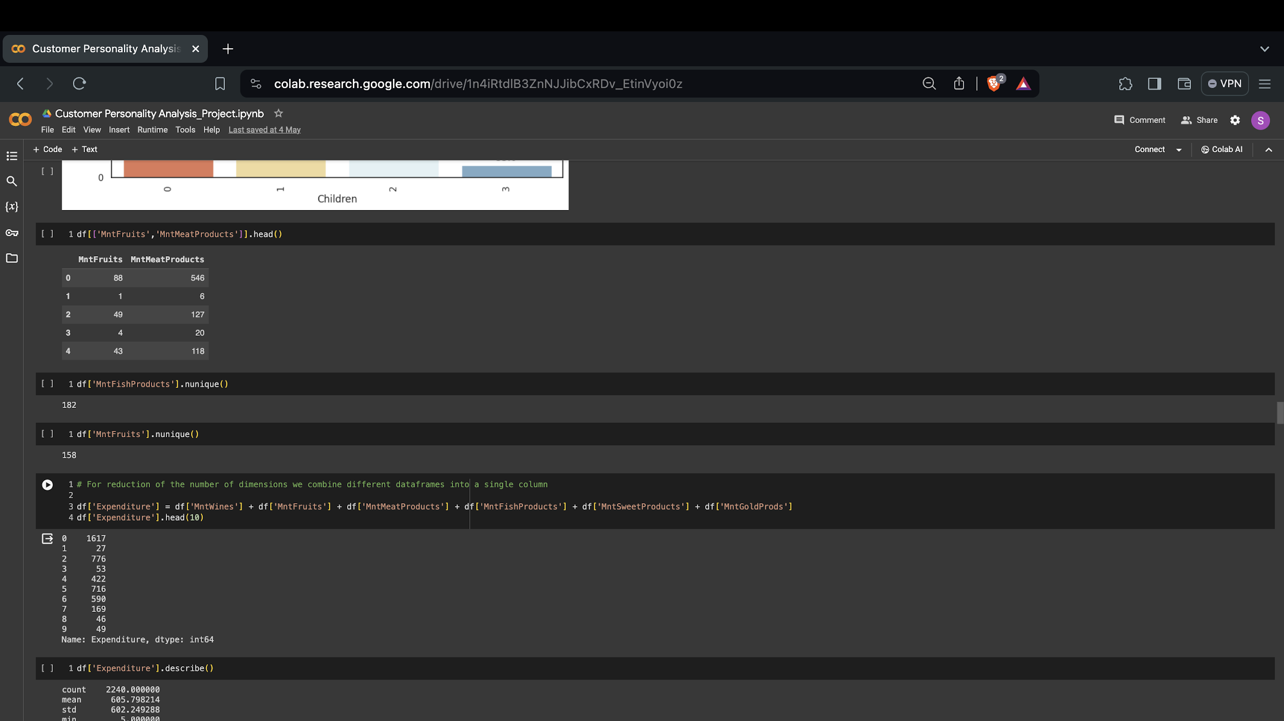
Utilising Univariate_ Analysing and combining related categories into a single column
Here we are combining multiple features such as Mnt Wines, Mnt Fruits, Mnt Meat Products, Mnt Fish Products, Mnt Sweet Products, Mnt Gold Products to come up with Expenditure column.

Slide 18
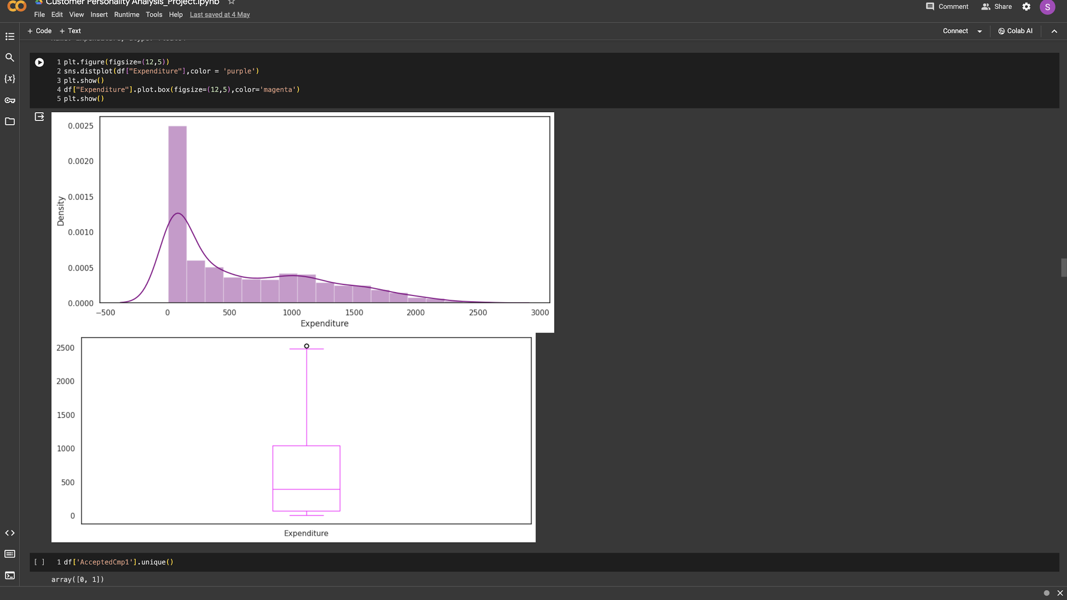
Utilising Univariate_ Analysing and combining related categories into a single column
According to the distplot and boxplot. The expenditure column is left skewed as we previously observed, but there are a few outliers which will be address while developing the model.

Slide 19
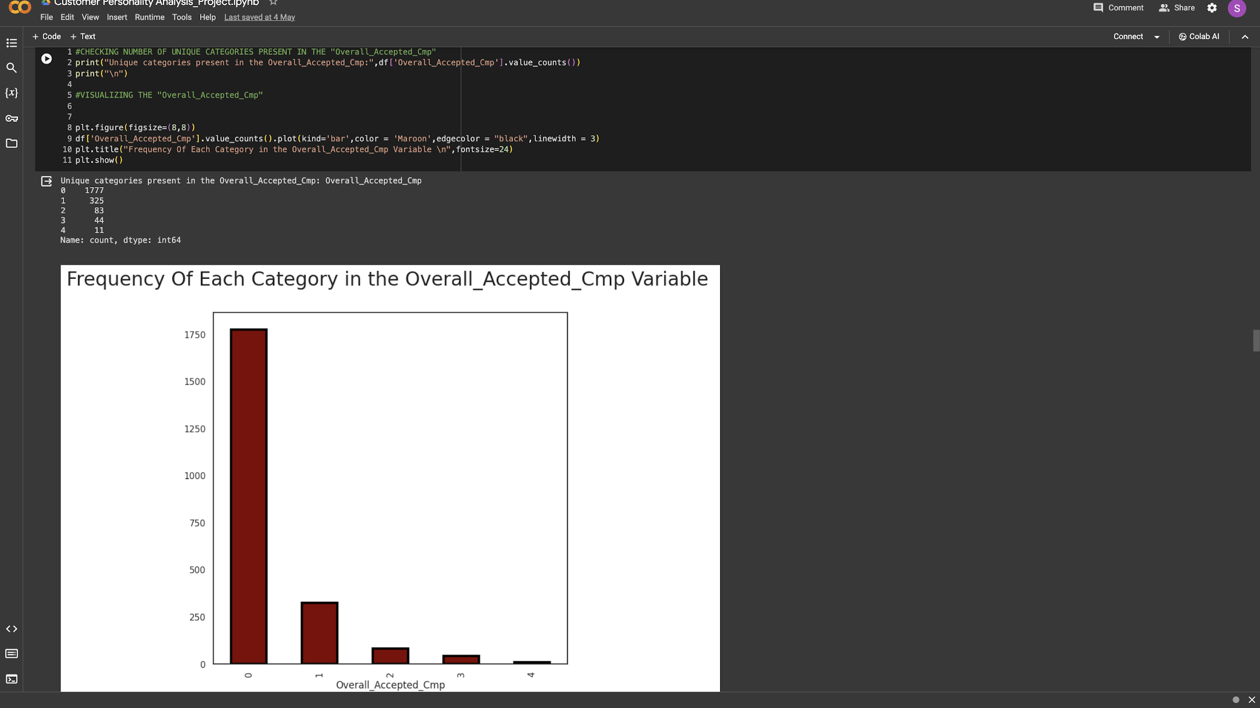
Utilising Univariate_ Analysing and combining related categories into a single column
Here we are combining multiple features to come up with Overall_Accepted_Cmp column. According the display count plot majority of the data points is held by ‘o’ campaign which is followed by one, two, three and four

Slide 20
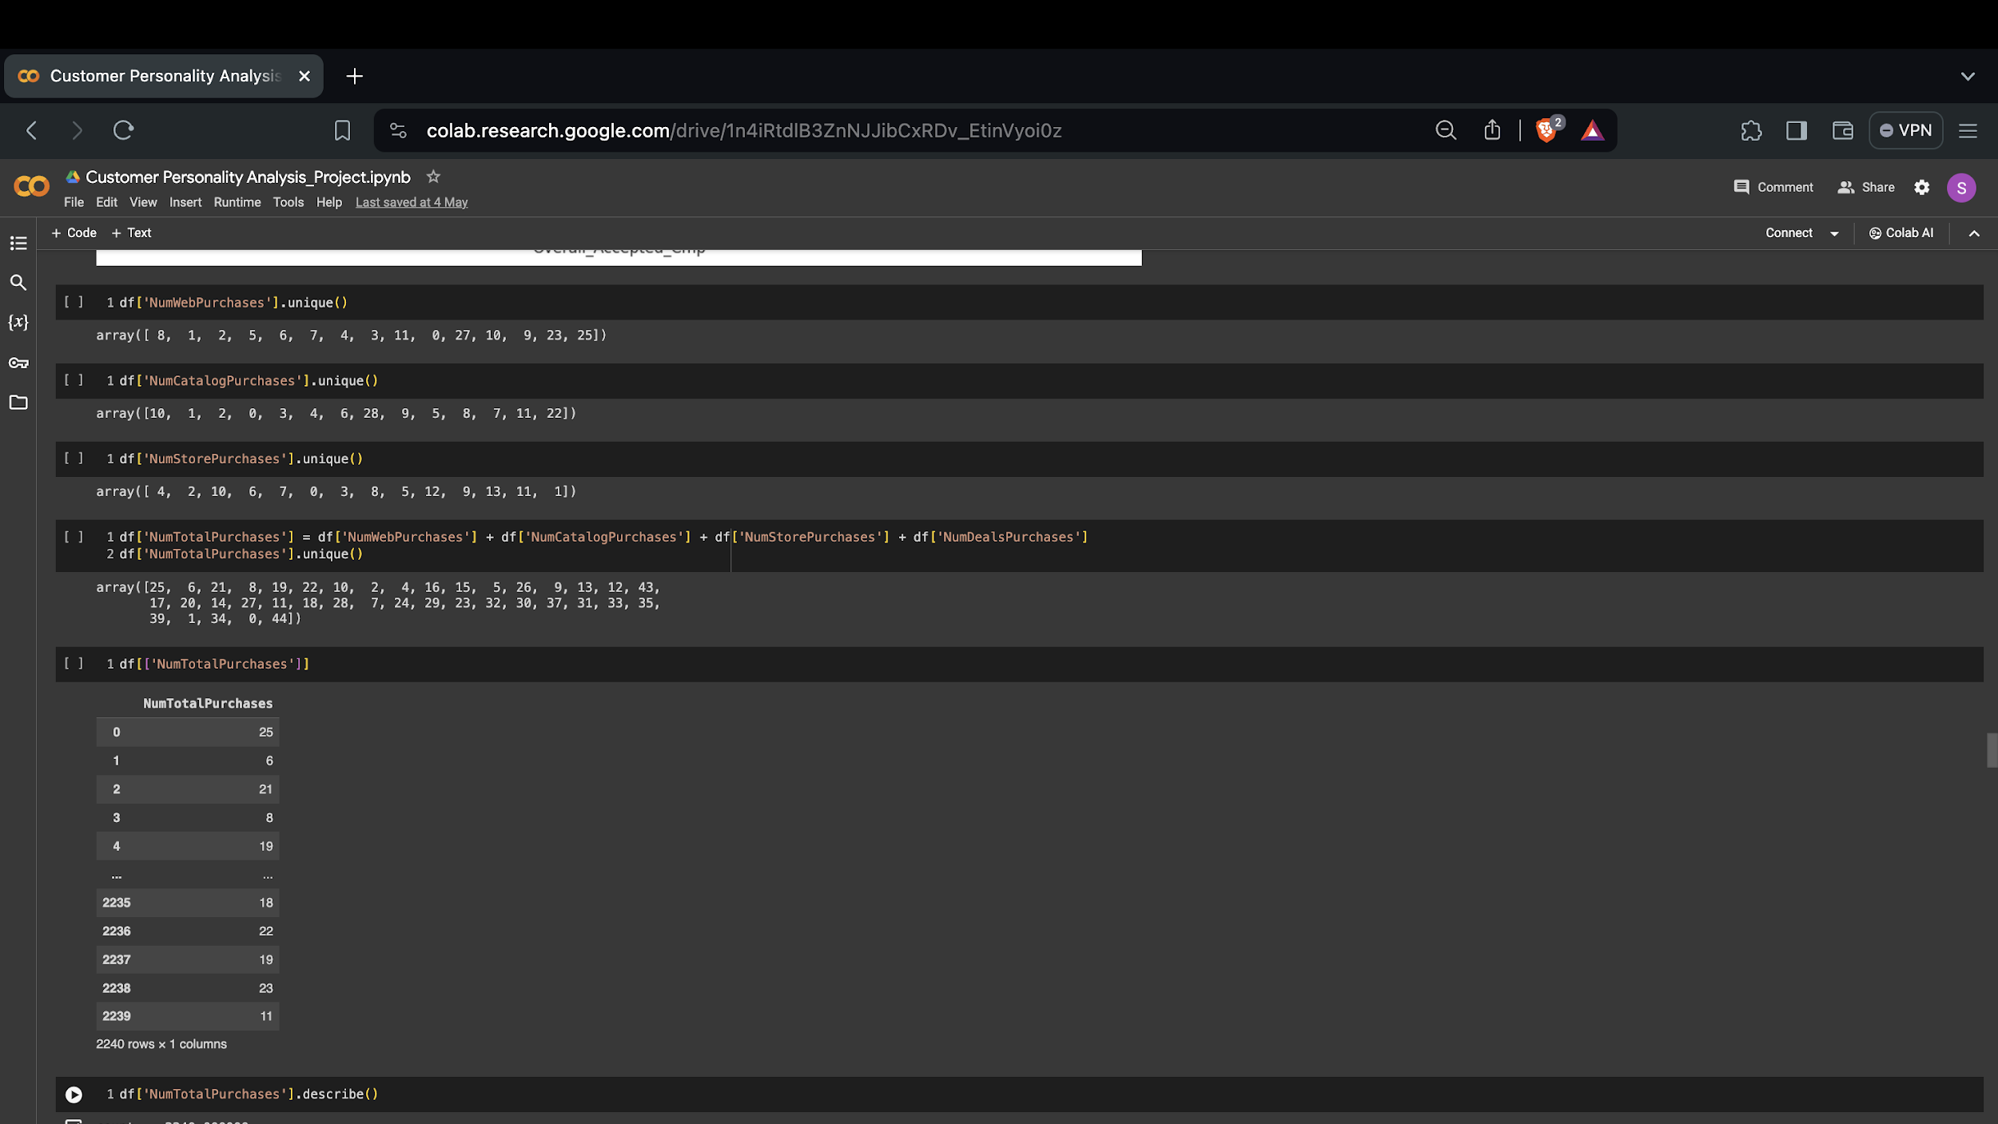
Utilising Univariate_ Analysing and combining related categories into a single column
Here we are combining multiple features numwebpurchases,numcatalogpurchases, numstorepurchases, numdealspurchases to come up with NumTotalPurchase column.

Slide 21
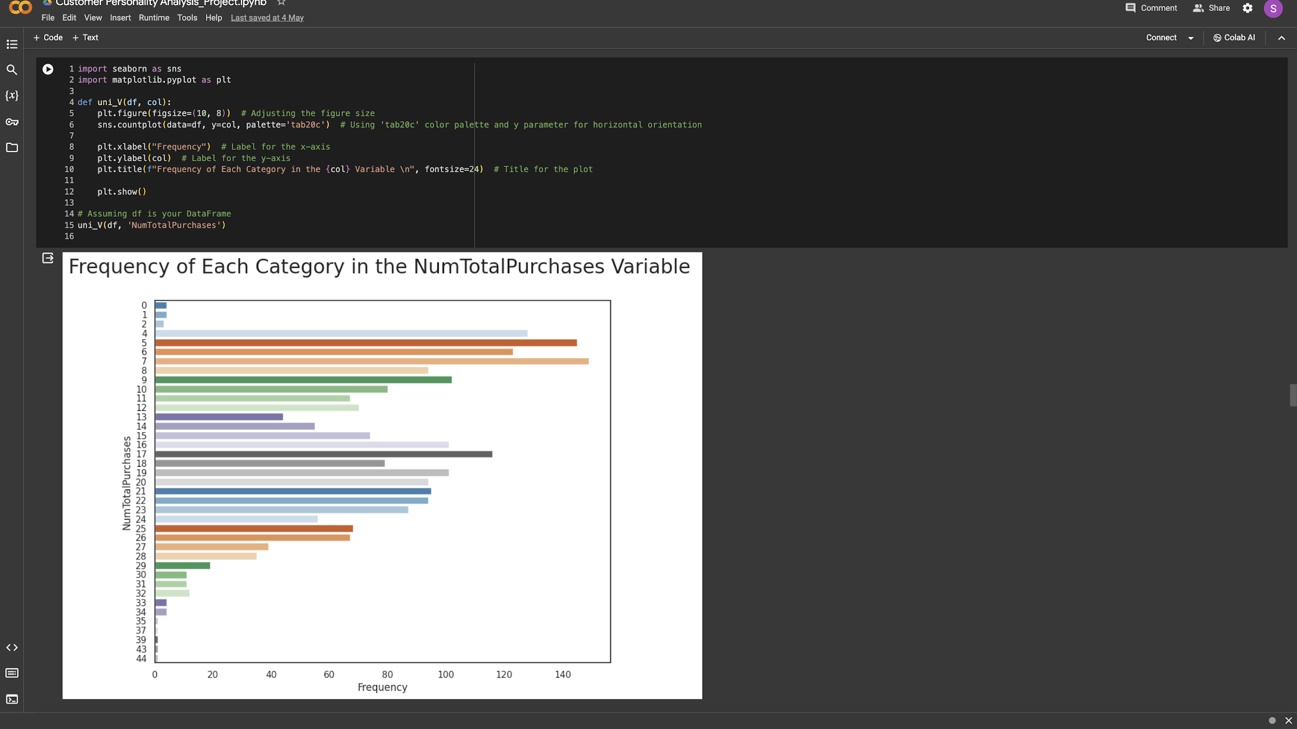
Utilising Univariate_ Analysing and combining related categories into a single column
According to the horizontal bar plot in the NumTotalPurchases the major frequency is made between 4 to 9. And the least frequency is made between 33 to 44

Slide 22
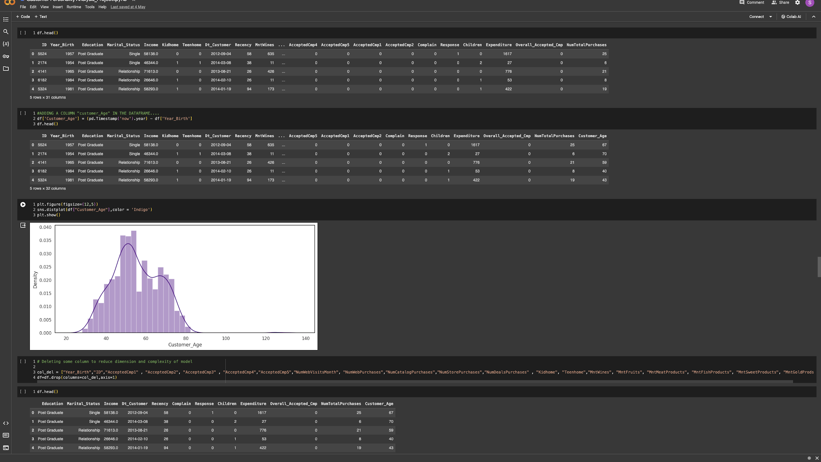
Utilising Univariate_ Analysing and combining related categories into a single column
According the dist plot the majority of spending is made by middle age group which is 35 to 55 years old

Slide 23
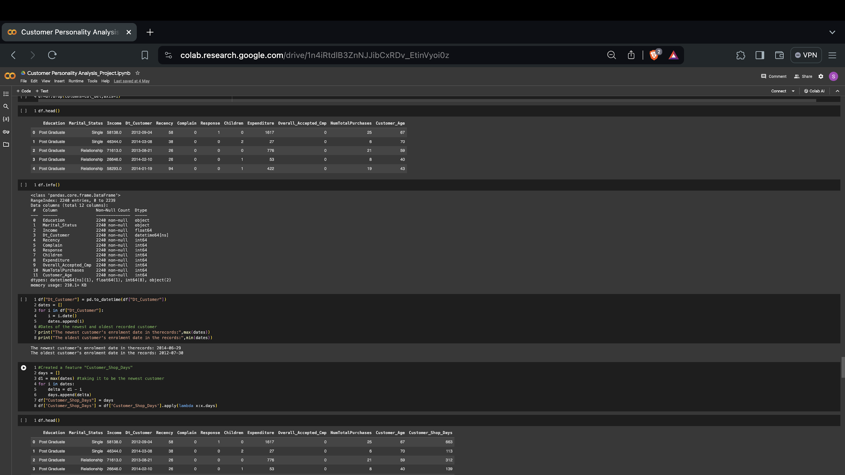
Utilising Univariate_ Analysing and combining related categories into a single column
Here, we did column elimination where we drop dimension including "Year_Birth", "ID", "AcceptedCmp1“,"AcceptedCmp2", "AcceptedCmp3“,"AcceptedCmp4","AcceptedCmp5” and others

Slide 24
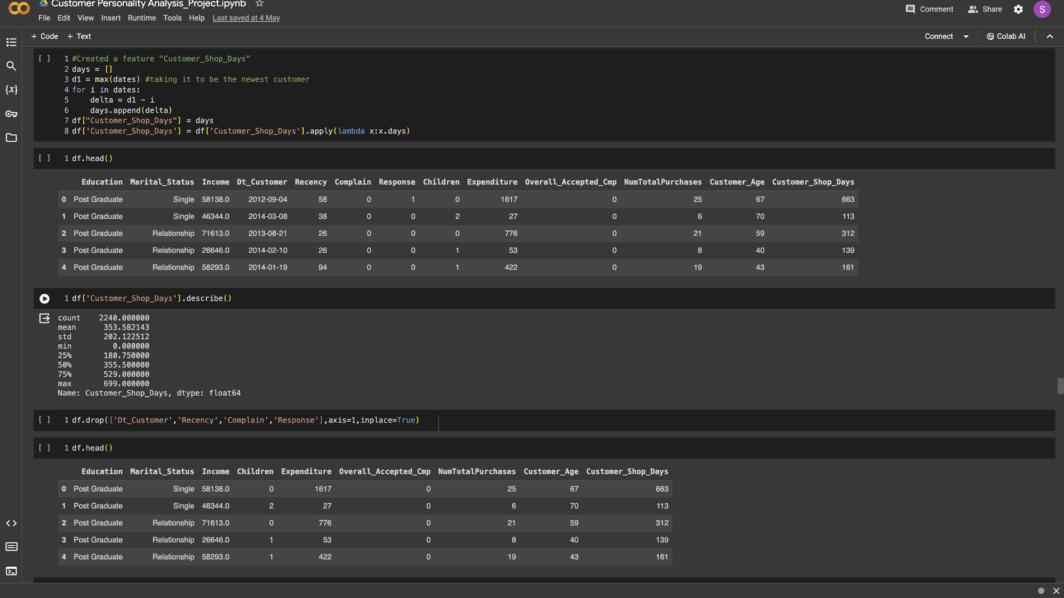
Utilising Univariate_ Analysing and combining related categories into a single column
Here, we are creating a feature ("Customer_Shop_Days") of the number of days the customers started to shop in the store relative to the last recorded date

Slide 25
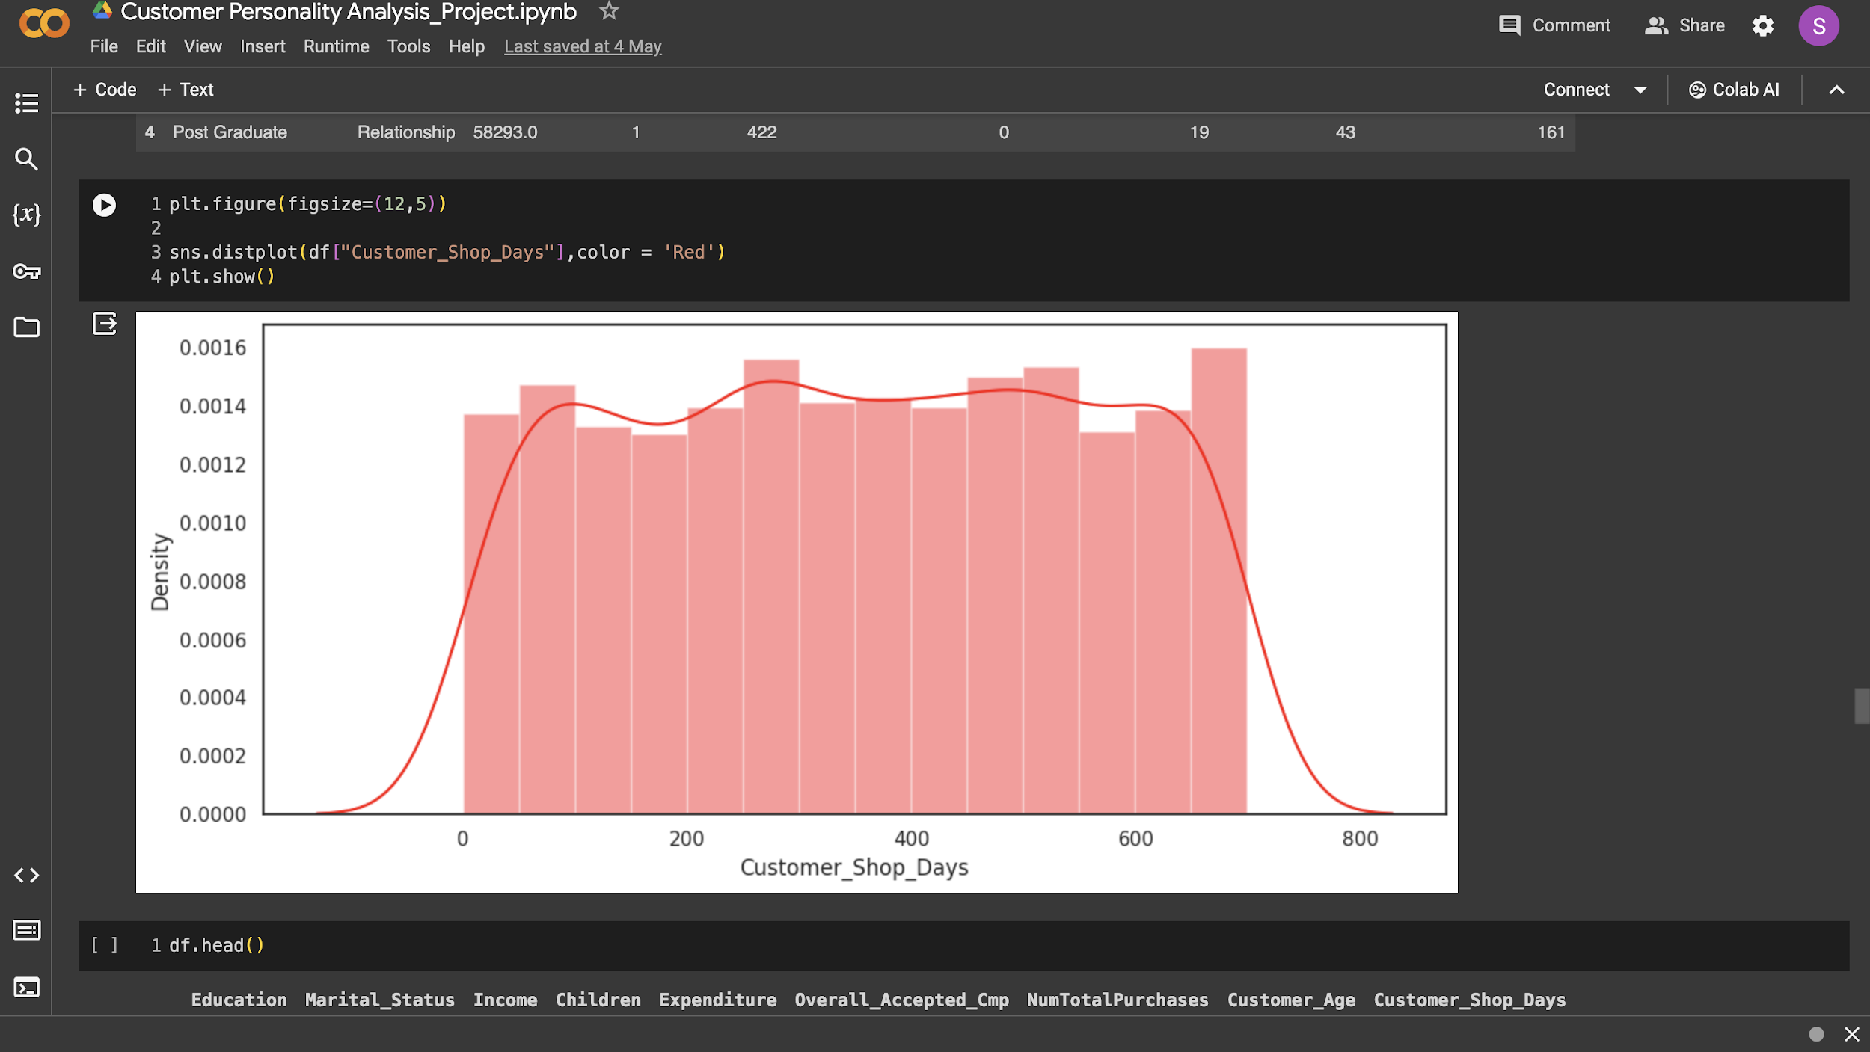
Utilising Univariate_ Analysing and combining related categories into a single column
The bar chart shows that 55 to 650 days are considered to be regular days of high density of customers shopping

Slide 26
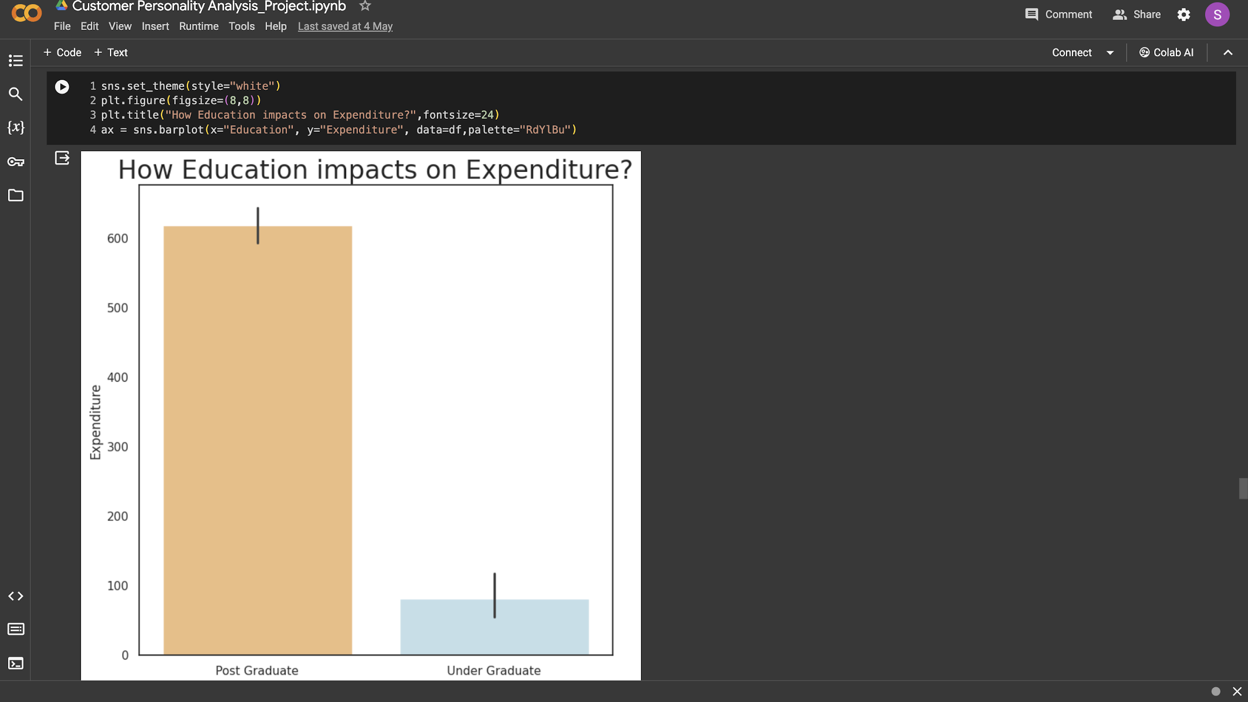
Using bivariate analysis Analysis to compare the features and expenses
The bar chart shows how Education have impact on Expenditure. It also display how Post Graduate have a significantly higher spending in comparison with Under Graduate.

Slide 27
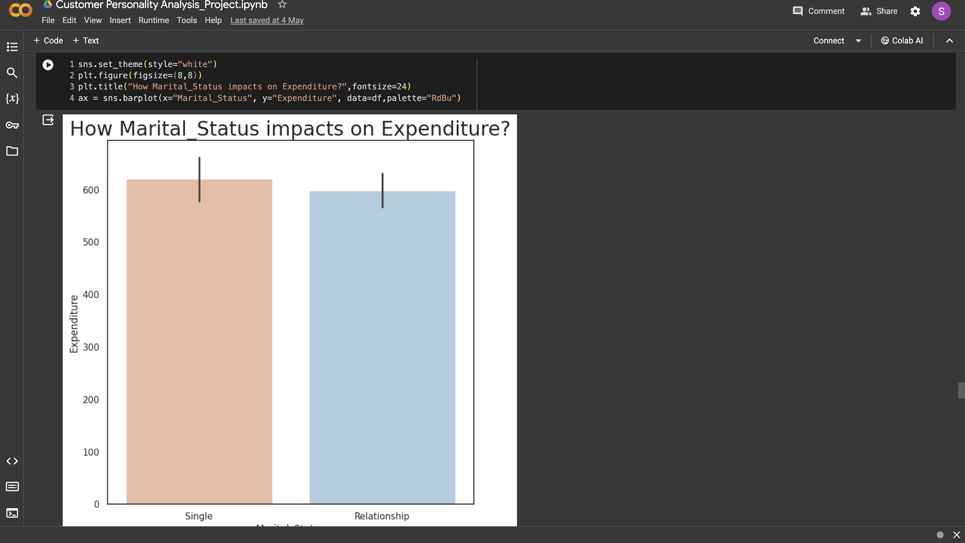
Using bivariate analysis Analysis to compare the features and expenses
The bar chart shows the expenditure based on marital status. It displays how single and relationship have almost similar expenditure and single has a slightly higher expenditure.

Slide 28
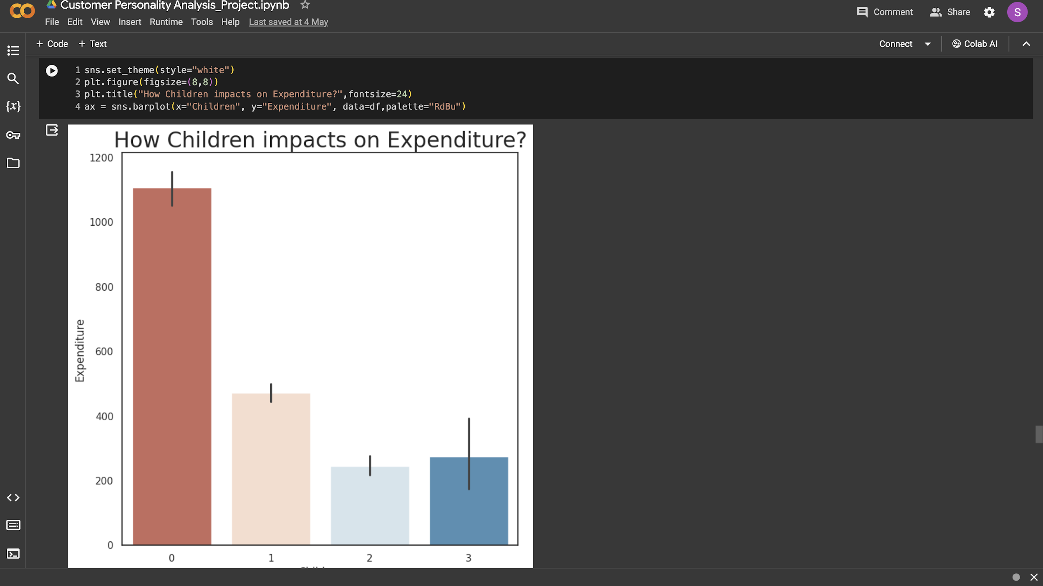
Using bivariate analysis Analysis to compare the features and expenses
The bar chart shows the expenditure among parents having children. It shows that parents with one child has more spending than parents with two or three children.

Slide 29
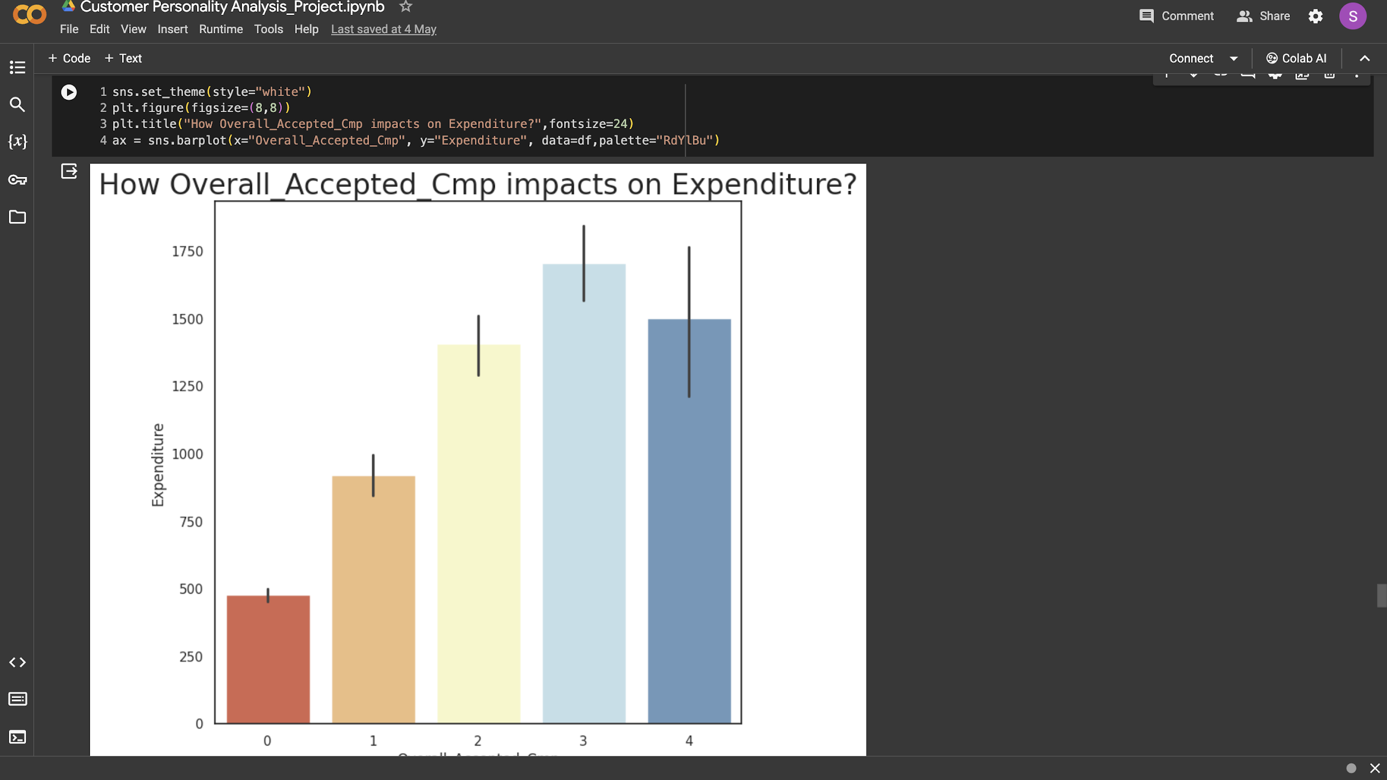
Using bivariate analysis Analysis to compare the features and expenses
The bar chart shows that those who accepted more campaign have more expenditure

Slide 30
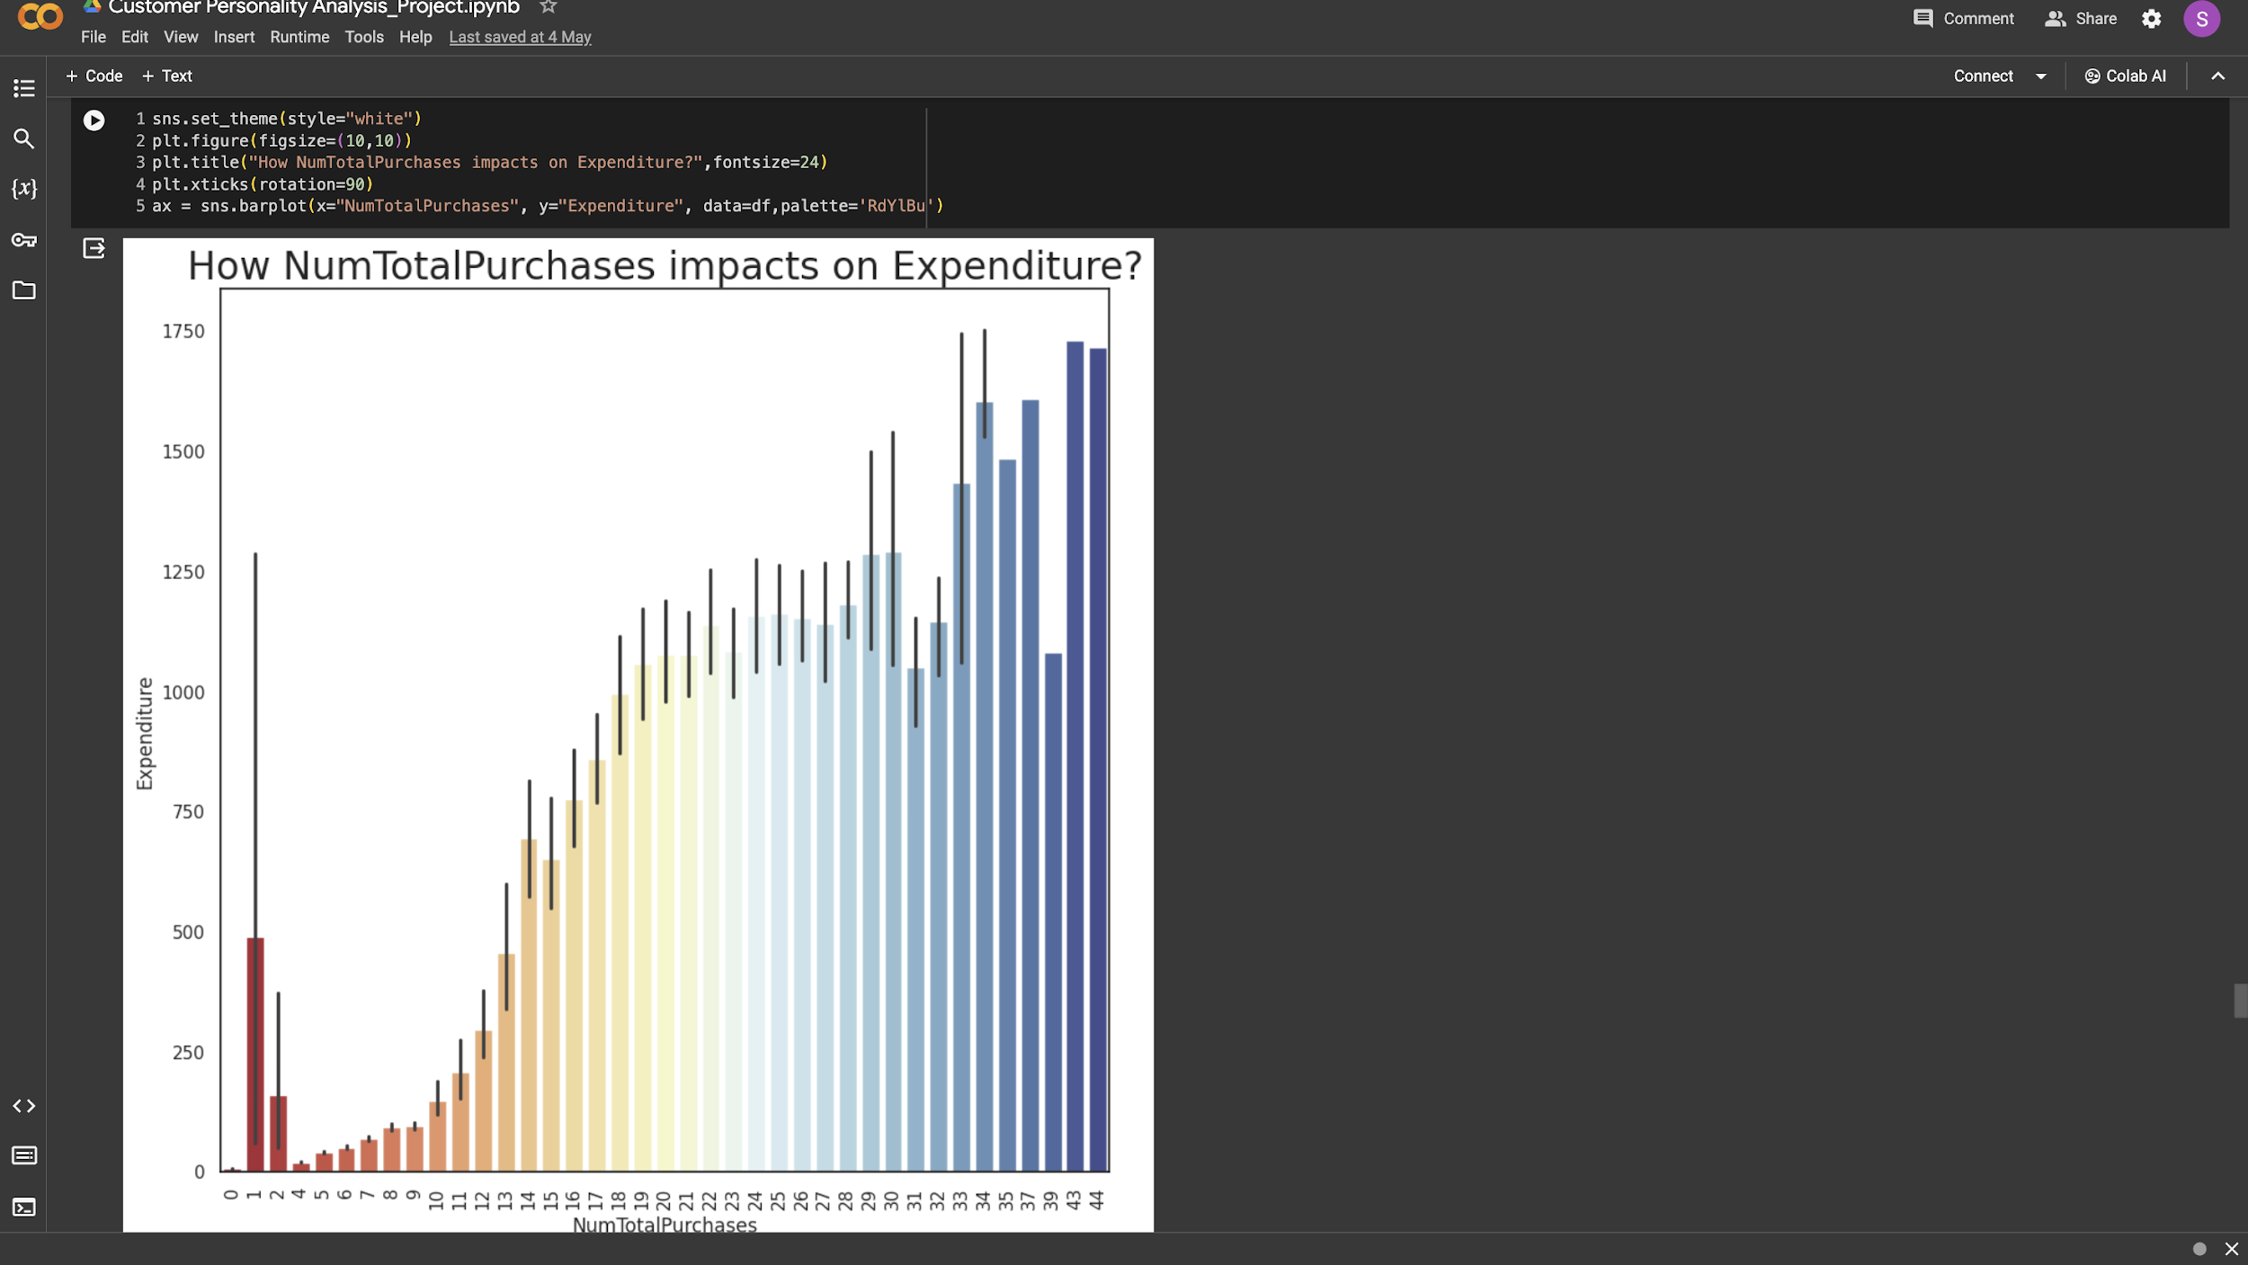
Using bivariate analysis Analysis to compare the features and expenses
The bar chart shows that the higher the purchase the higher the expenditure.

Slide 31
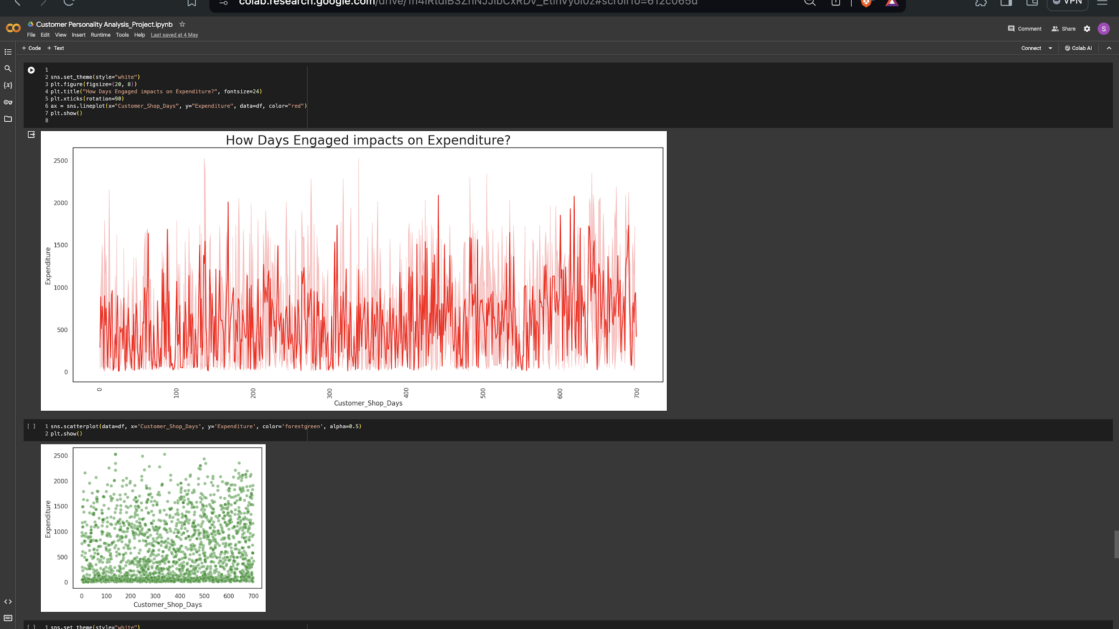
Using bivariate analysis Analysis to compare the features and expenses
The influence of days active on spending is seen in the line plot. Spending is represented as a scattered plot depending on client shop days.

Slide 32
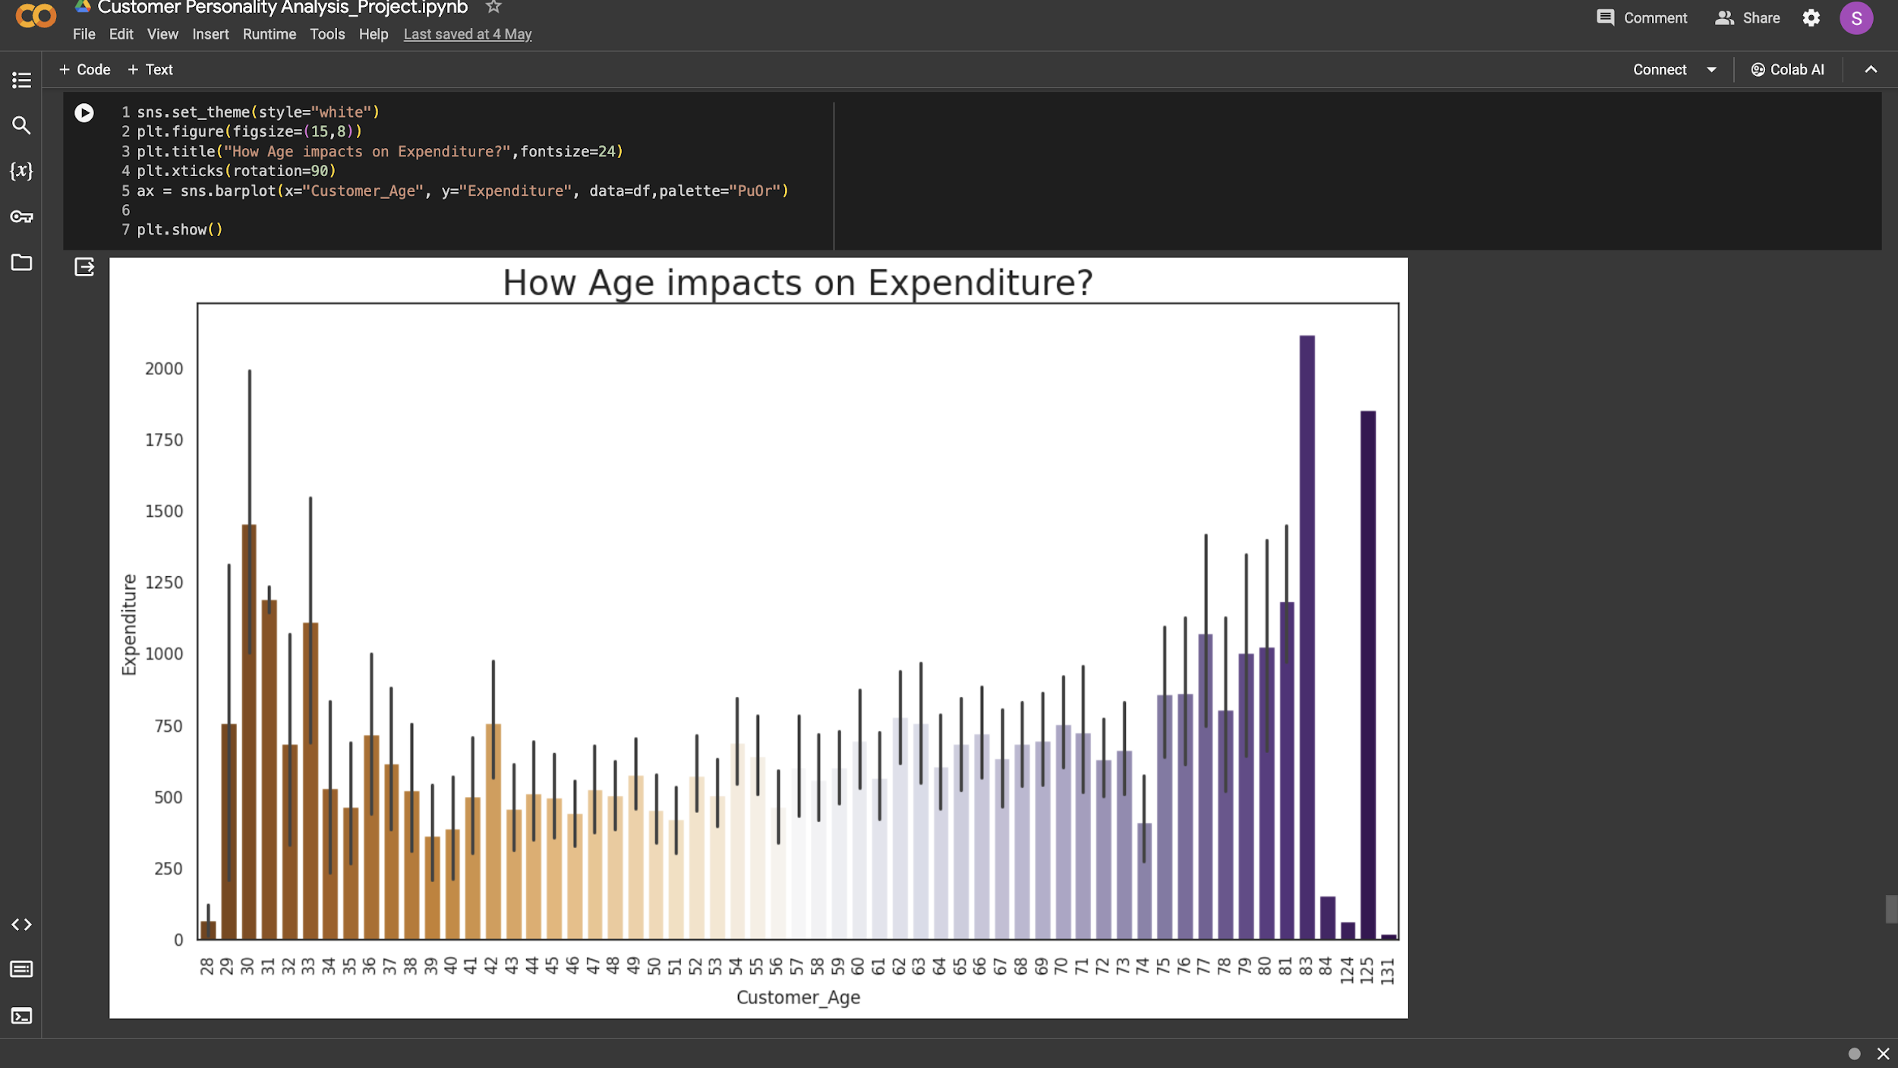
Using bivariate analysis Analysis to compare the features and expenses
The bar graph indicates that middle-aged individuals spend less money than other demographic groups.

Slide 33
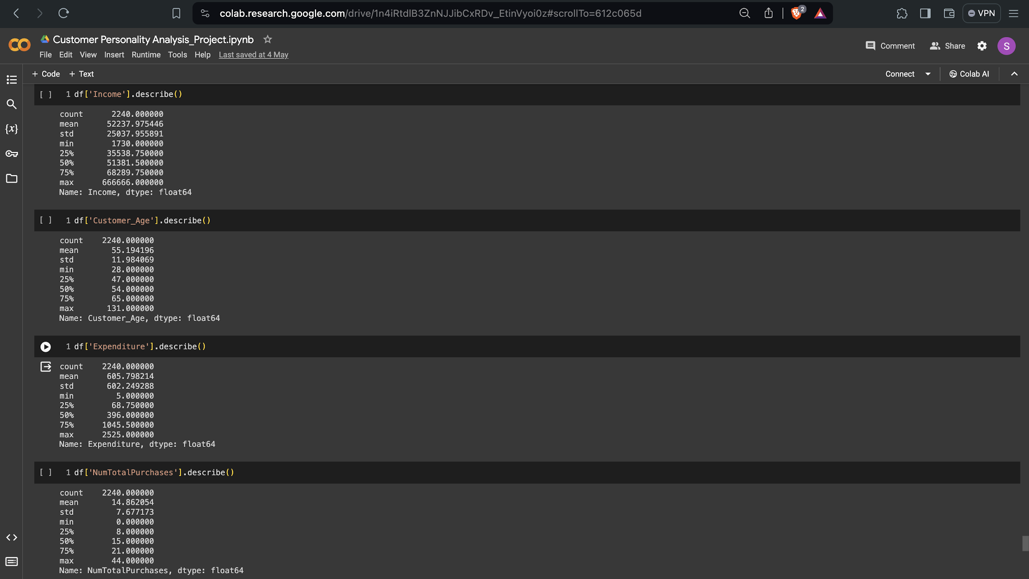
Removing Outliers
In this case, we utilise describe() to show 25% and 75% of the dimensions needed to remove outliers from these features.

Slide 34
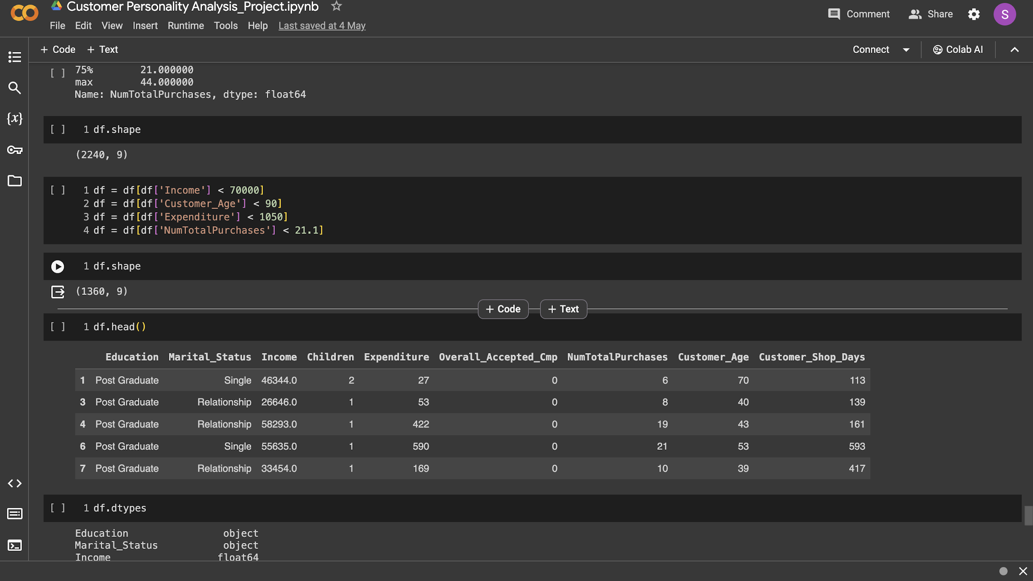
Removing Outliers
To remove outliers from these characteristics, we apply the given algorithm.

Slide 35
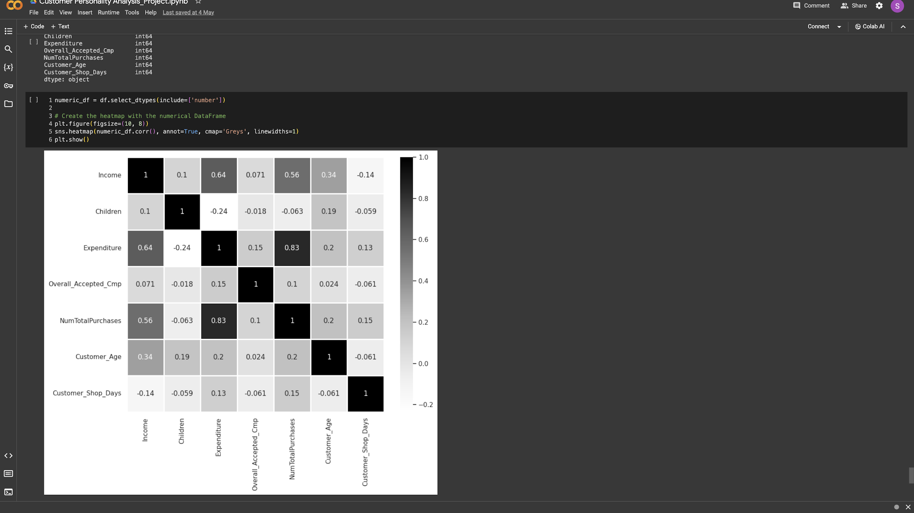
Finding Correlation
Income and expenditure, as well as the amount of purchases made, are more positively correlated.Children and spending are negatively correlated, whereas income and the quantity of purchases made are positively correlated with spending.

Slide 36
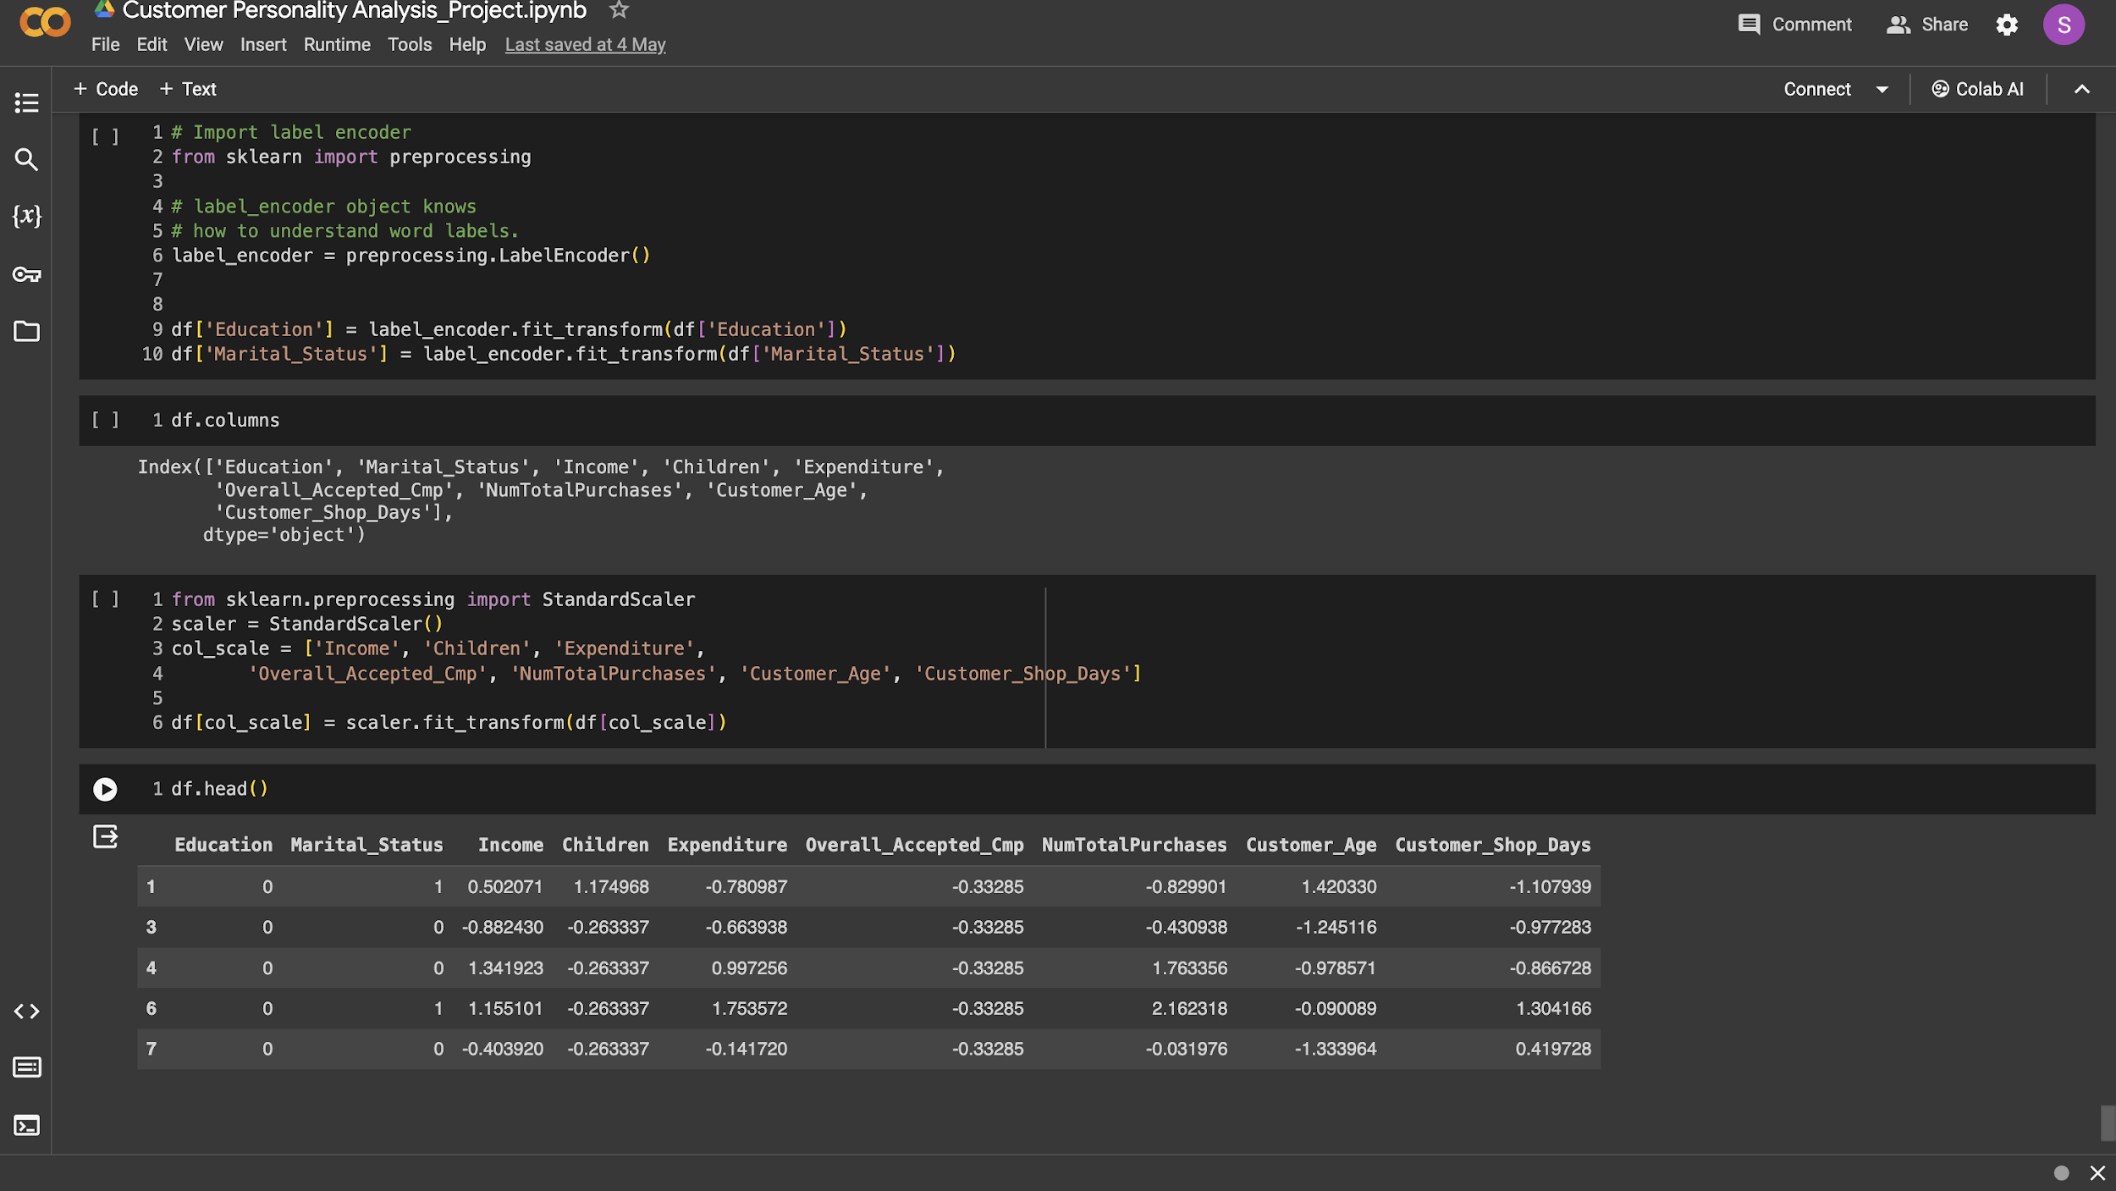
Standardizing the Data
Here, we've completed the preprocessing using the standard scaler and label encoding method. We are now going to use this specific record to create the model.

Slide 37
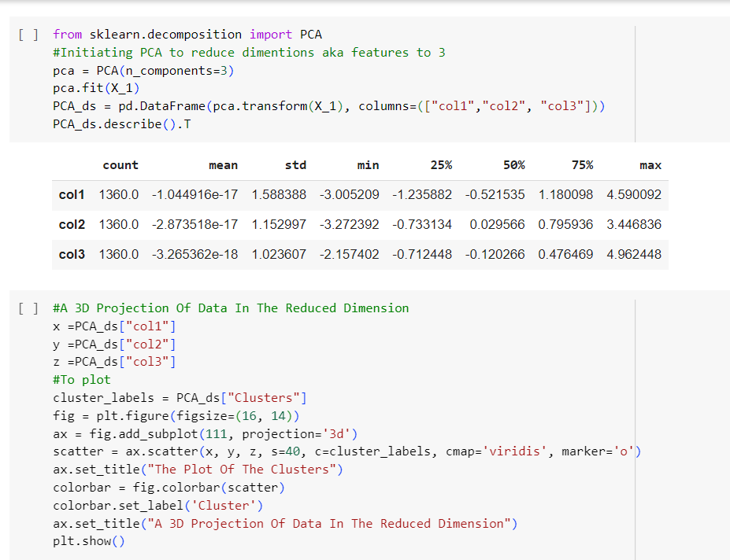
This is the code for drawing the elbow method based on PCA which helps us to find the number of clusters we are going to be using in the algorithm

Slide 38
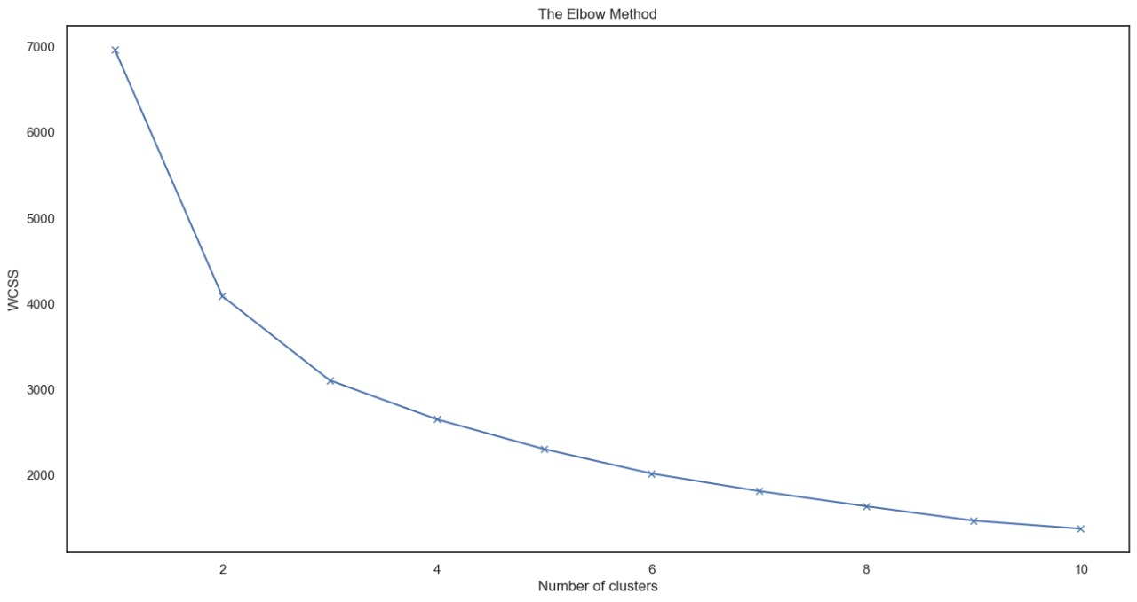
WCSS is the sum of the squared distance between each point and the centroid in a cluster.
wcss values is more less for k=2 here...so we take k=2

Slide 39
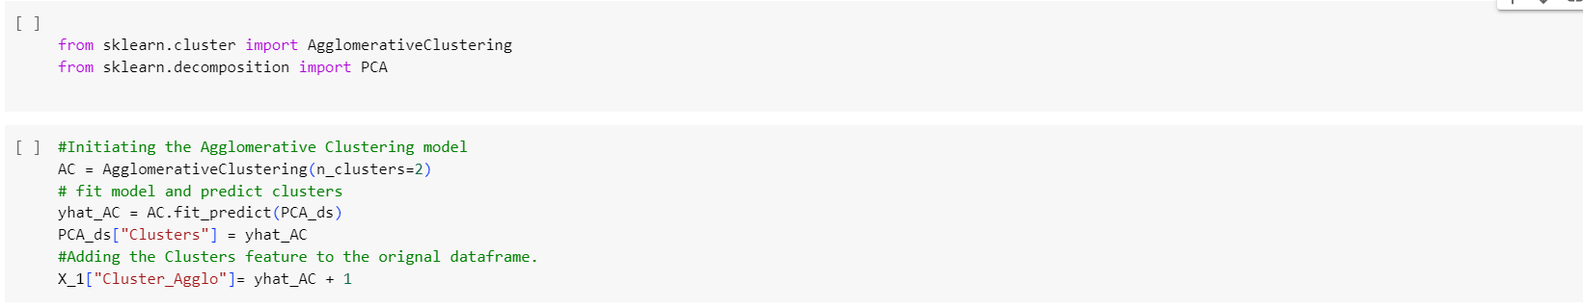
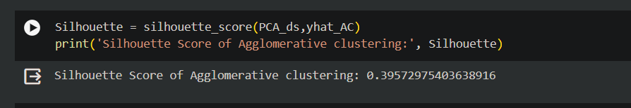

Slide 40
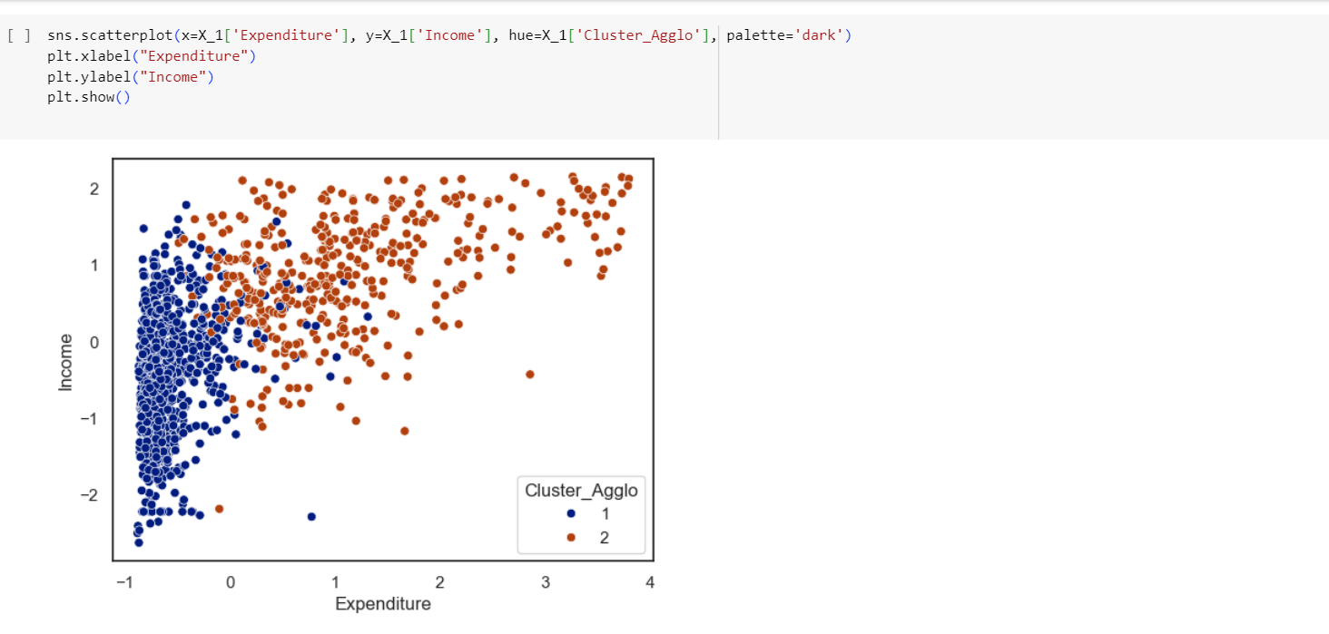

Slide 41
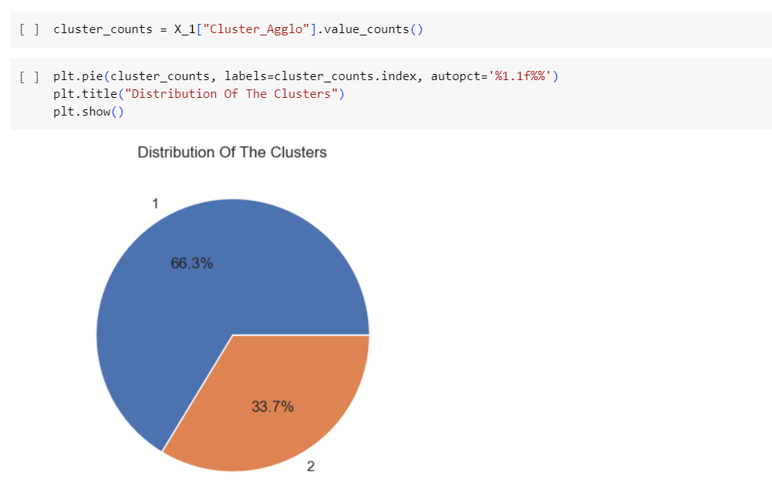

Slide 42
Cluster 1:
People with less Expenses
People who are Married & Parents of more than 3 Childrens
People with low Income
Cluster 2:
People with more Expenses
People who are Single or Parents who have less than 3 Children
People with High Income
Age is not the criteria, it is observed to some extent that older People fall in this group
So, the Customers falling in Cluster 2 like to spend more. So the firms can target People falling in Cluster 2 for the sale of their Products...

Slide 43
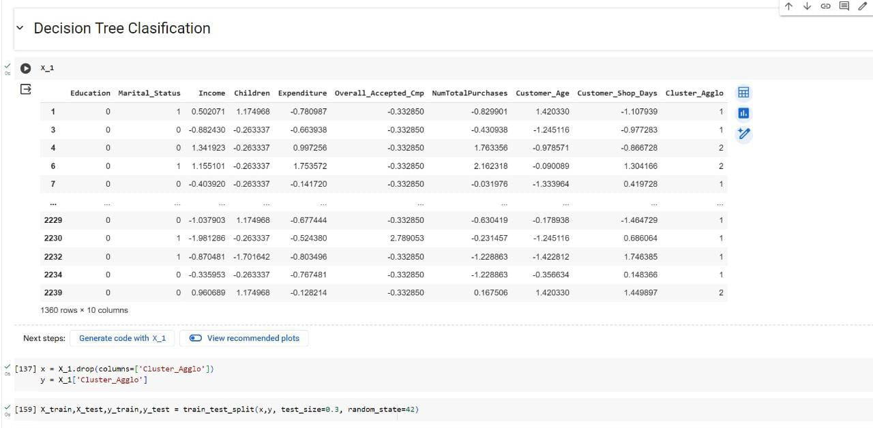
Here, we performed Decision Tree Classification by taking Agglometric Clustering data X_1

Slide 44
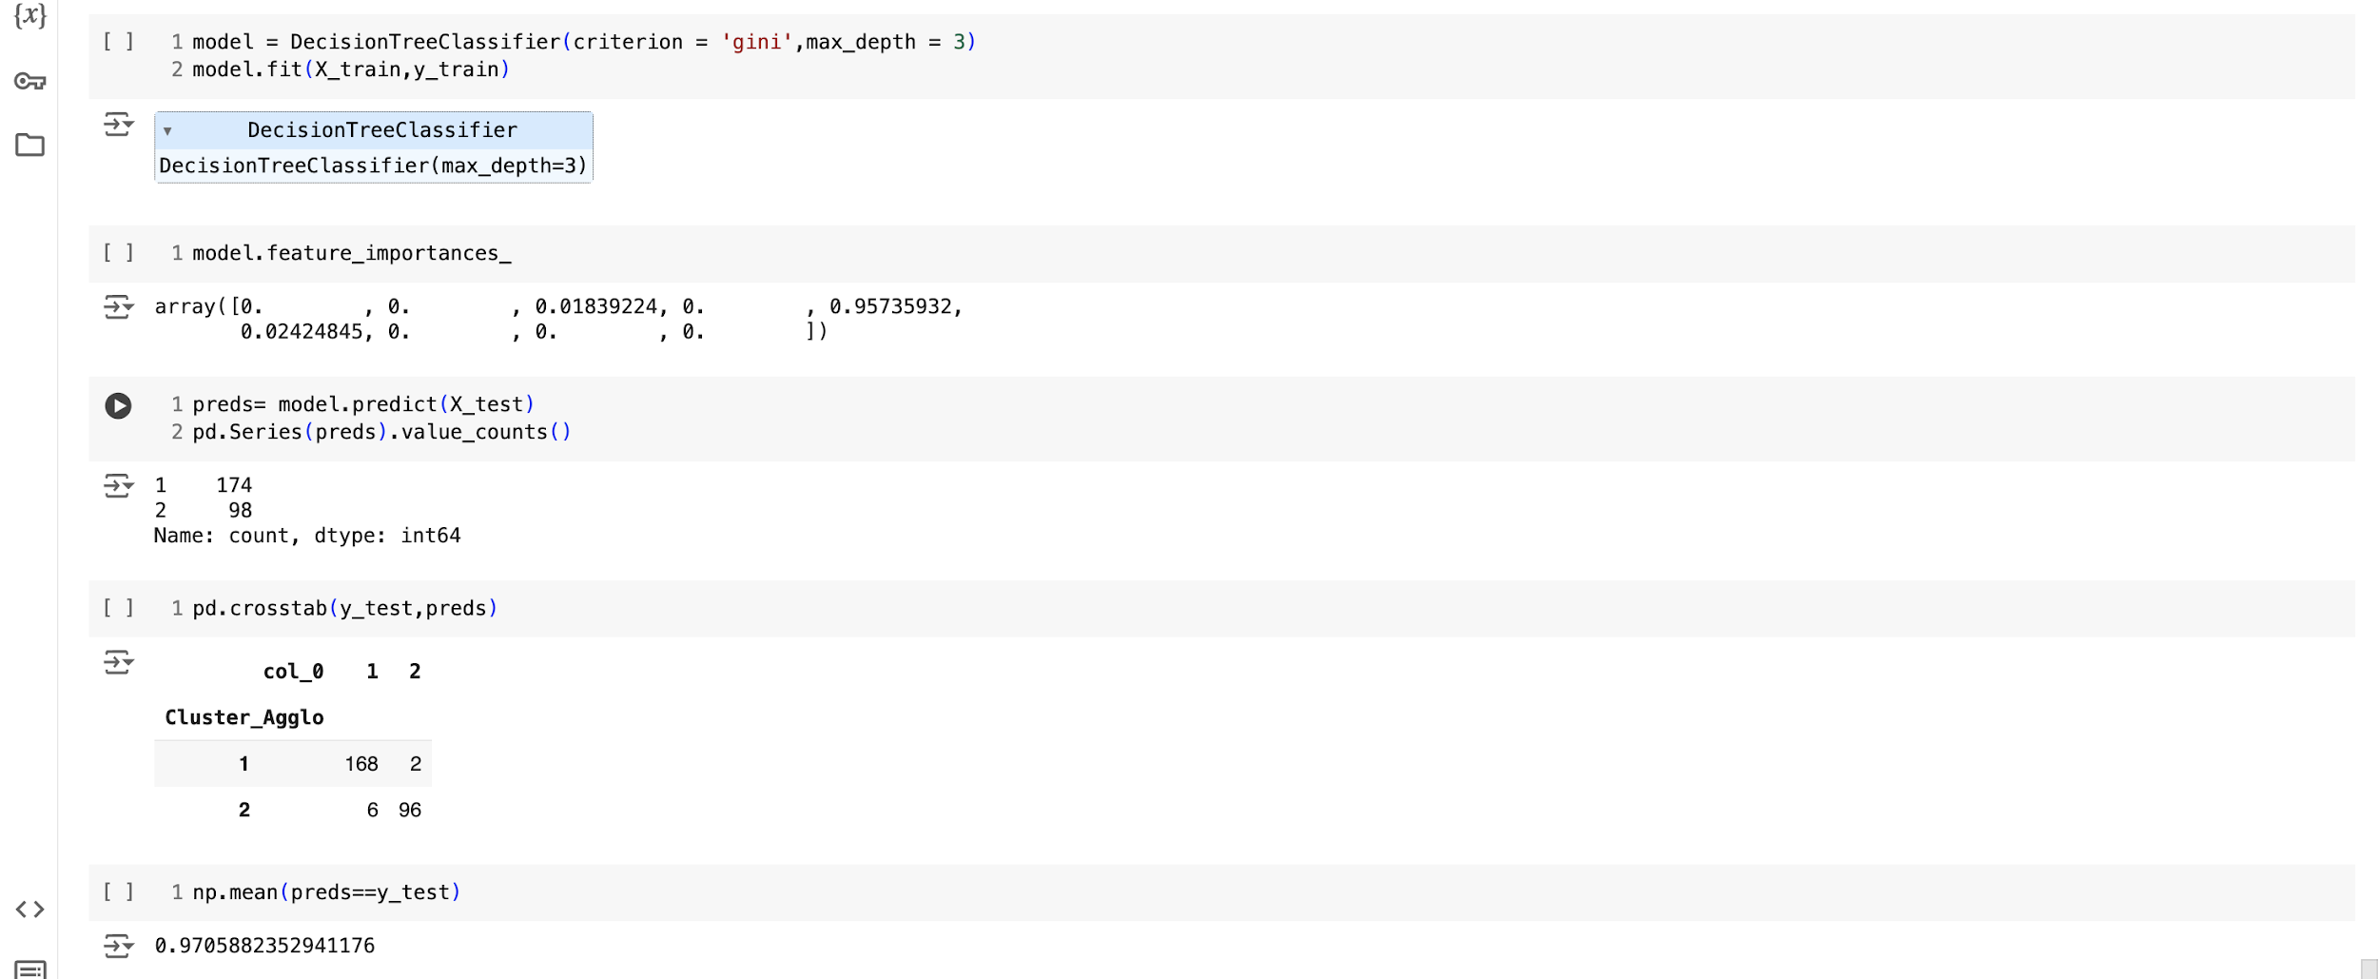
Testing data 0.3% and training data 0.7% using decision tree classification criterion = Gini and we got 97% accuracy

Slide 45
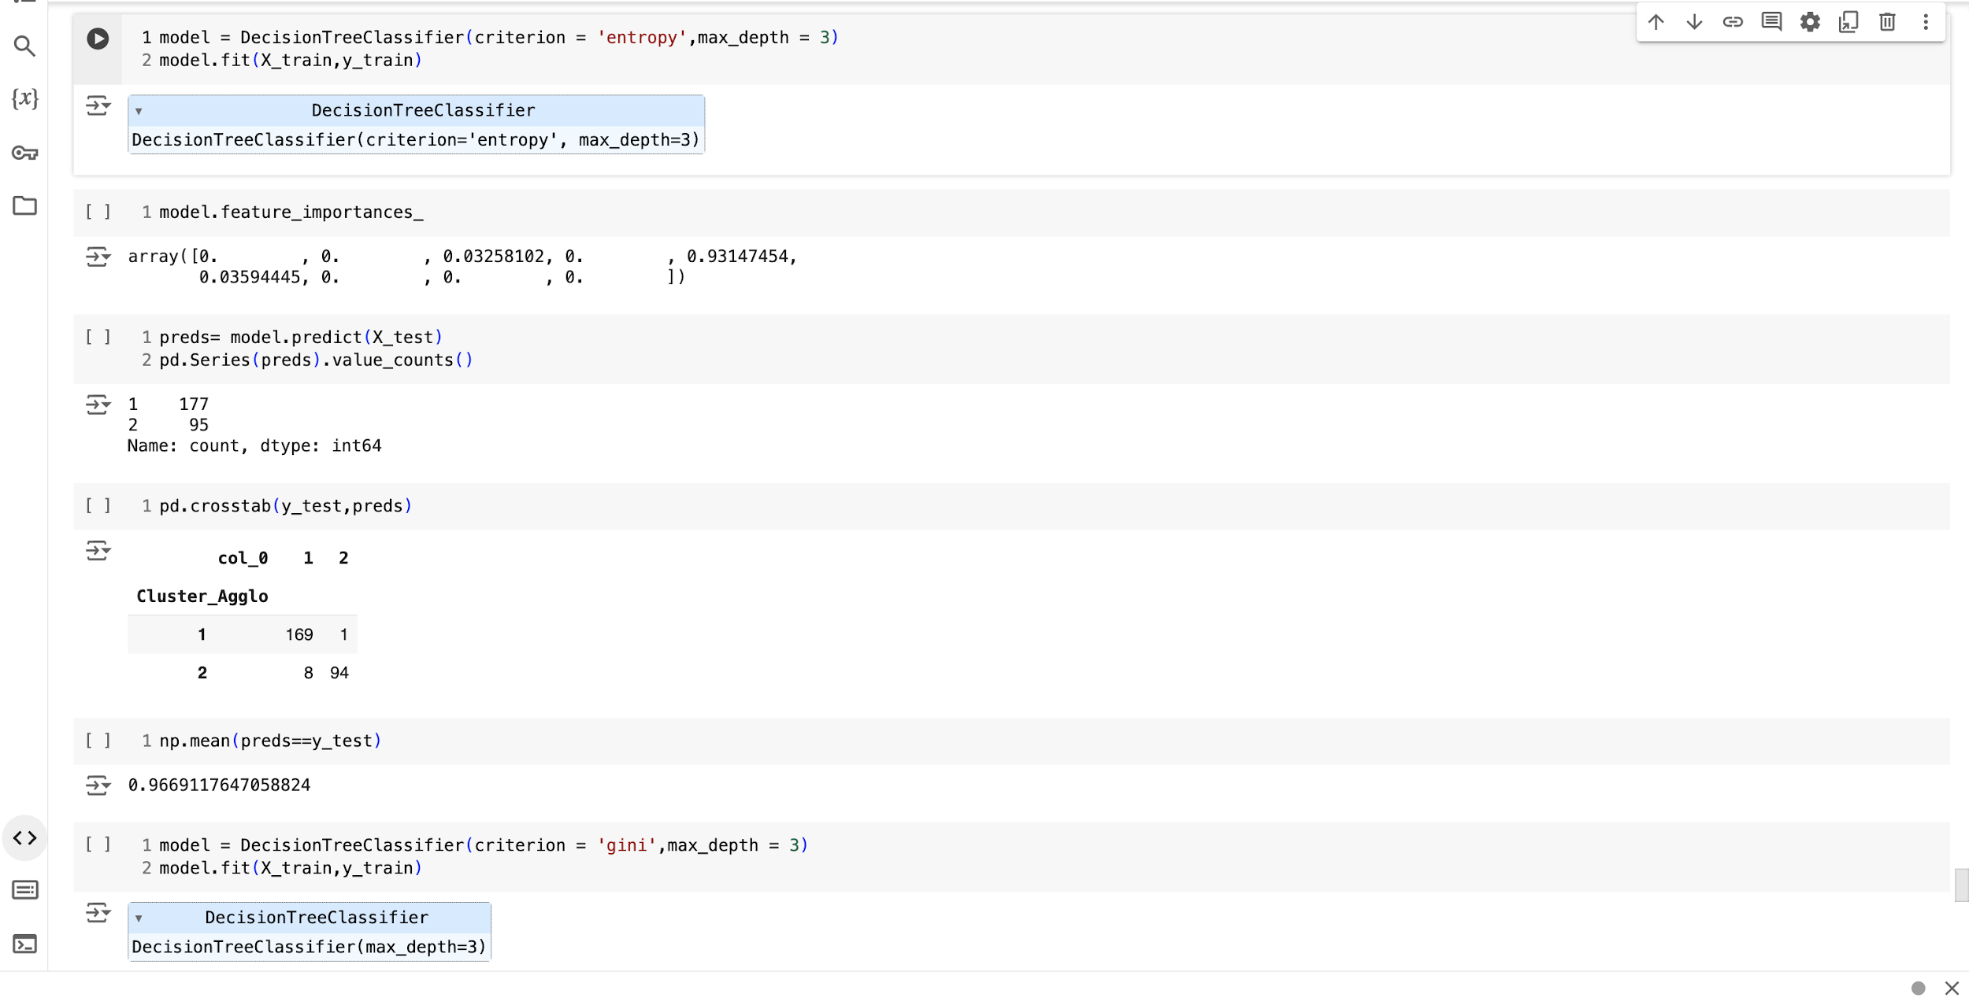
After changing criterion = entropy we got an accuracy of 96%

Slide 46
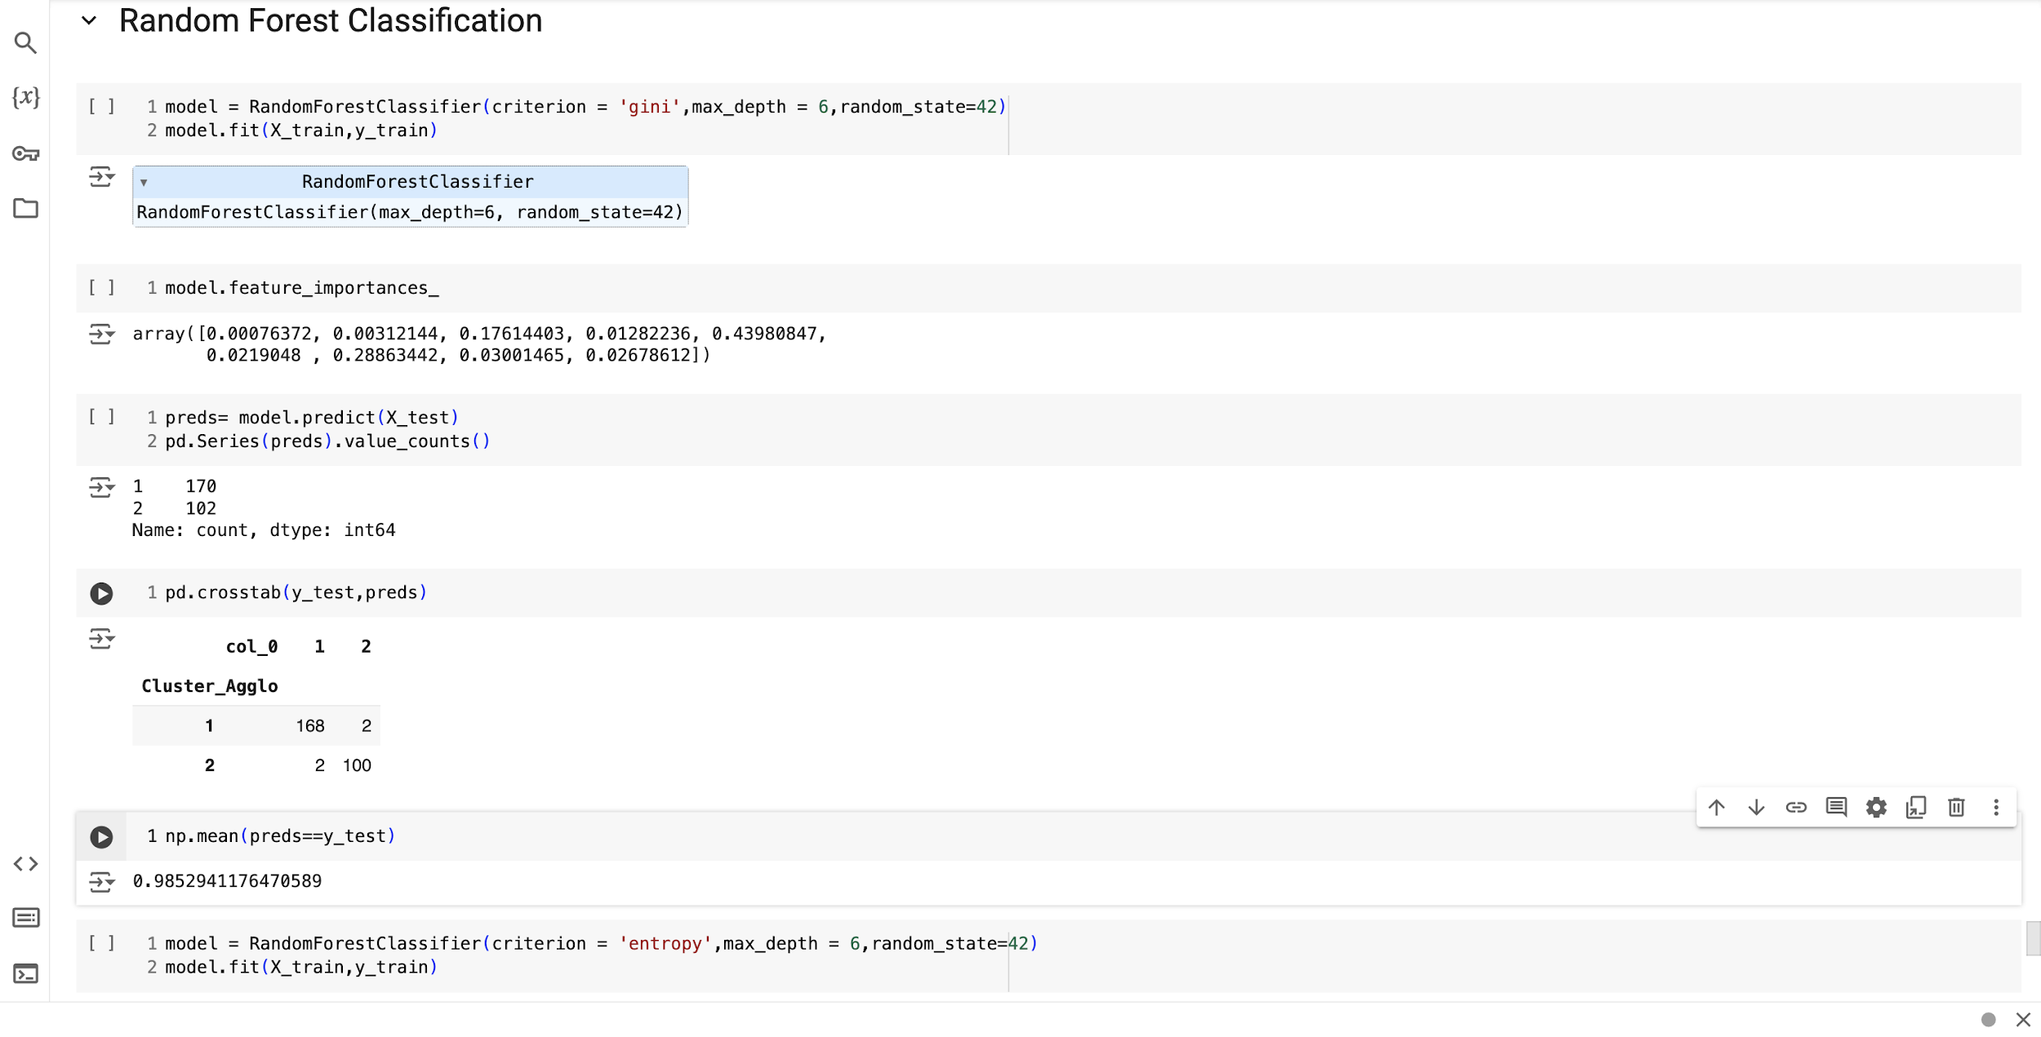
Applying Random Forest classification on the same data(agglomerative) testing data = 0.3% and training data = 0.7%

Slide 47
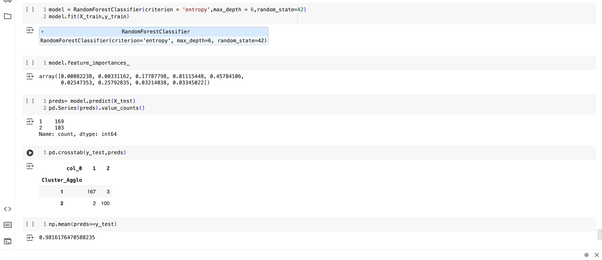

Slide 48
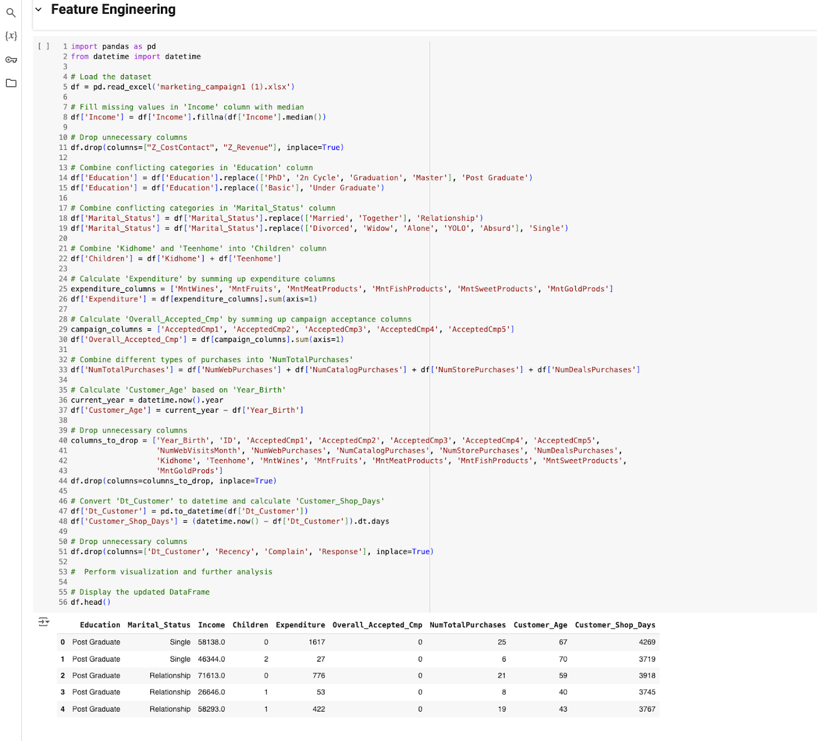

Slide 49
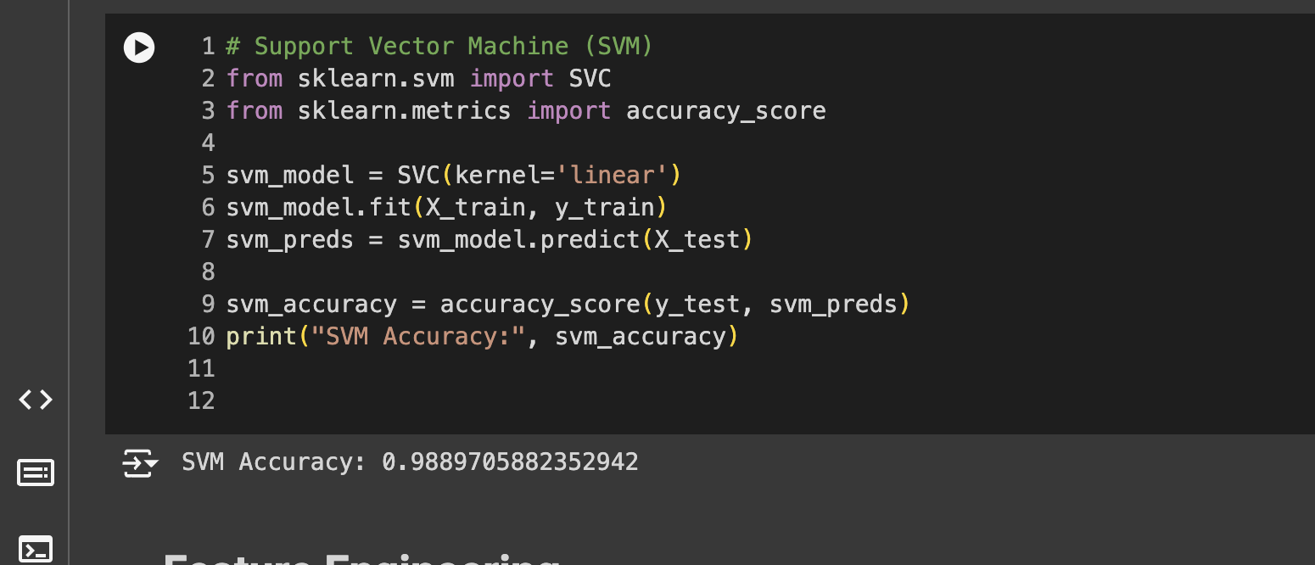
SVM

Slide 50
Model Deployment
Here, we have taken Support Vector Classifier (SVM) as our Final Model algorithms for the deployment.
The algorithm has achieved 95% Accuracy scores, on testing data.
95% accuracy is achieved by using the model Support Vector Classifier no misclassification on validation set.
We have deployed the Customer personality Analysis using Stream-lit as the platform.

Slide 51
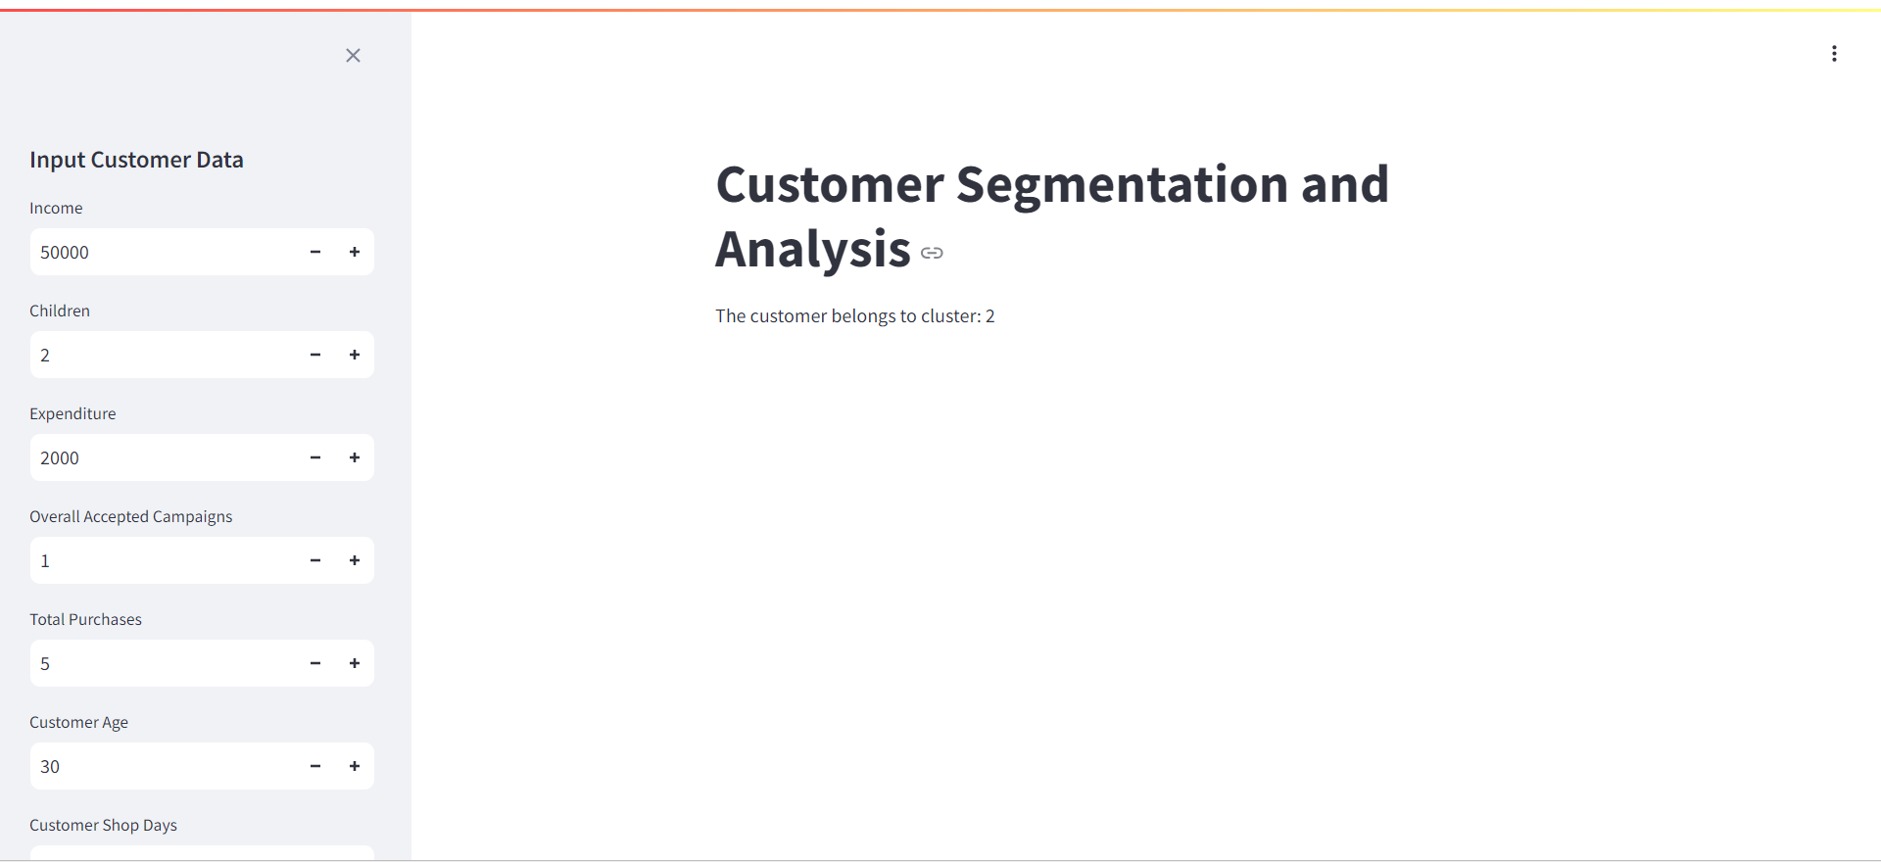

Slide 52
Challenges
Challenges Faced?
We faced the challenges regarding to set up the pipeline for the deployment.
We faced the challenges to determine the best accuracy for the model building.
We used the Streamlit platform to deploy the code and used the data from the given dataset to get the predicted output.
We resolved the accuracy of the model with the help of training and testing dataset by using the different types of algorithms.

Slide 53
Thank You

